Slide 1
Broadband Network Management: Wired and Optical Access Networks
Chapter 13
Week 11
Chapter 13 in Subramanian, Gonsalves & Rani (2010). You ignore the slides from 11 to 32 and from 76 to 82 so do not consider:
Management of Cable Network
Management of Passive Optical Network
27 slides removed = 56
Notes:
Chapter 13
*

Slide 2
Objectives
Chapter 13 Broadband Network Management: Wired and Optical Access Networks
(Wired) Broadband access networks
Cable or HFC (hybrid fiber cable) network
ADSL (asymmetrical digital subscriber line) network
PON (passive optical network)
Cable access network
Popular in North American continents
“Triple play” service can be provided
DOCSIS (data over cable system interface specifications) standards
ADSL
Predominant throughout the rest of the world
Uses conventional telephone local loop medium
Broadband voice and data services
Adopts IETF and DSL forum standards
VDSL2 for performance improvement of broadband service
PON
PON deployment configurations
Ethernet-based PON, EPON
EPON protocol architecture
EPON management
EPON MIBs

Slide 3
BROADBAND ACCESS NETWORK
We learned the general concepts about broadband wide area network (WAN) and services in the previous chapter. We will now address the basics of technologies and management of access networks in this chapter.
As shown in Figure 12.1 in the last chapter, three different types of customers have access to the broadband network. The first type is a corporate or enterprise user who has a campus-wide network. The second type is the service provider. The third type is a residential and small business customer, who has multimedia requirements. However, they typically have neither a sophisticated LAN environment nor large bandwidth requirements in both directions.
In the first customer type, access to broadband WAN for corporate or enterprise customers is accomplished by an optical fiber link from the WAN router or switch to a campus device, which could be either a switch or a router.
The second type of user, a service provider, can be one of several choices: a cable operator, or a local exchange carrier or telephone company, or a multiple system operator (MSO) who multiplexes several services, such as telephony, video, and data services. The interface to the WAN in this case is via a gateway. The physical link between the gateway and the WAN depends on the demographic configuration. The third type of customer, namely residential and small business office, is the focus of broadband access network and technology. We will address the wired access networks including passive optical network (PON) in this chapter. We will cover wireless access networks in Chapter 14.
Access networks to customer premises from the backbone MPLS/ATM/IP WAN are shown in Figure 13.1. One of the access networks is the OC-n/STS-n links. It generally has a router or a switch at either end of the access network. It is primarily used for enterprise connection.
Four categories of access technologies are currently available either in deployable or developmental stage for connection to residential and small and medium business customers. Two access networks that are extensively deployed now are networks based on HFC (Hybrid Fiber Coaxial)/cable modem (CM) and digital subscriber line (DSL).
Figure 13.1 also shows the third and fourth access networks, which are a wireless customer network and a PON, which are in the early stage of deployment and are trailing behind cable and ADSL. Another method of getting broadband service to home is via a satellite communication network. This is primarily one-way to the customer location and is not easily amenable for interactive broadband communication due to large propagation delay.

Slide 4
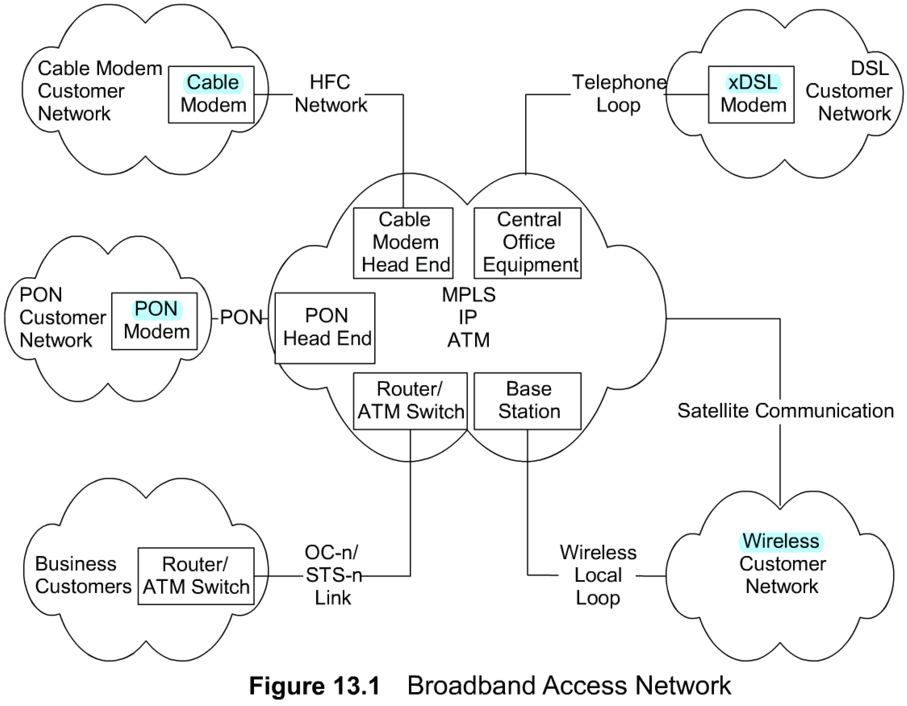
Broadband Access Networks
Chapter 13 Broadband Network Management: Wired and Optical Access Networks
There are four modes of access using four different technologies. As shown in Figure 13.2, they are cable, DSL, wireless, and PON communication.
Satellite communication technology is not presented in the figure as it is not deployed as access network to home and SME.
Cable access network technology uses television transmission facilities and CMs. Cable access network could be implemented as either one-way with telephony-return or two-way.
The DSL has three different implementations and is generally referred to as xDSL, where x stands for asymmetric (A), high-speed (H), or very high data rate (V). All are based on using existing local loop telephone facilities.
Wireless access technology uses wireless transmission for the downstream link to the customer site and either wireless or telephony-return for the upstream link from the customer site. Wireless access network can be implemented either as fixed wireless or mobile wireless.
PON technology is technically ready for commercial deployment, but has been delayed due to business considerations of cost and lack of need for large bandwidth to residential customers.
Notes
Access network between WAN and home network
Four access network technologies
OC-n an extension of WAN for enterprise

Slide 5
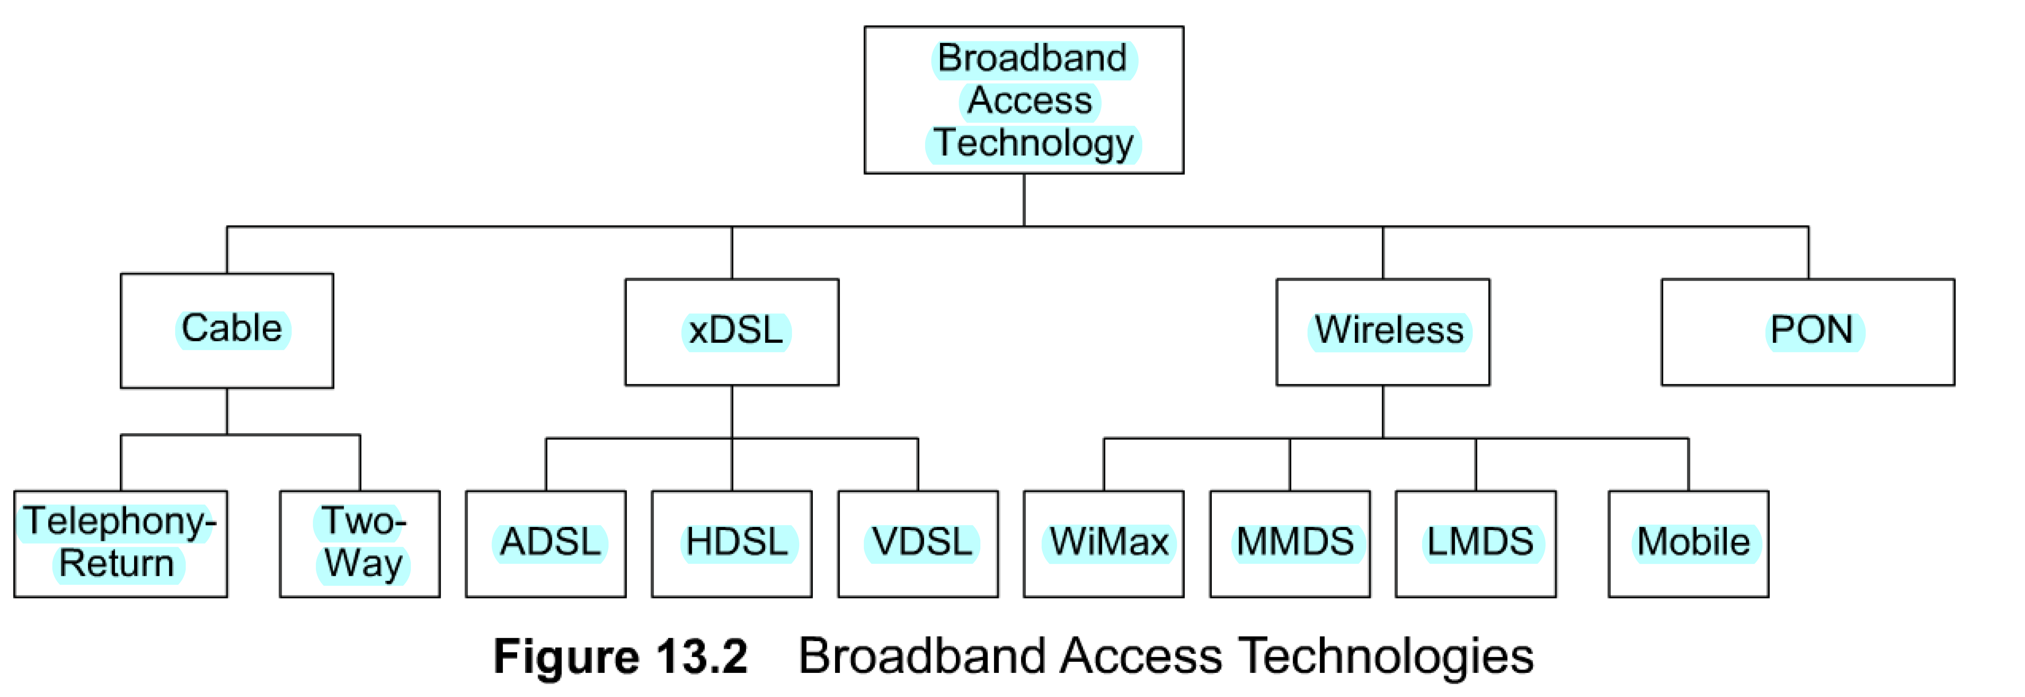
Broadband Access Technologies
Chapter 13 Broadband Network Management: Wired and Optical Access Networks
Notes
Cable popular in North America
ADSL more extensively deployed elsewhere in the world
Wireless:
Fixed: MMDS, LMDS, and WiMax
Mobile: CDMA, GPRS
PON on fiber medium

Slide 6
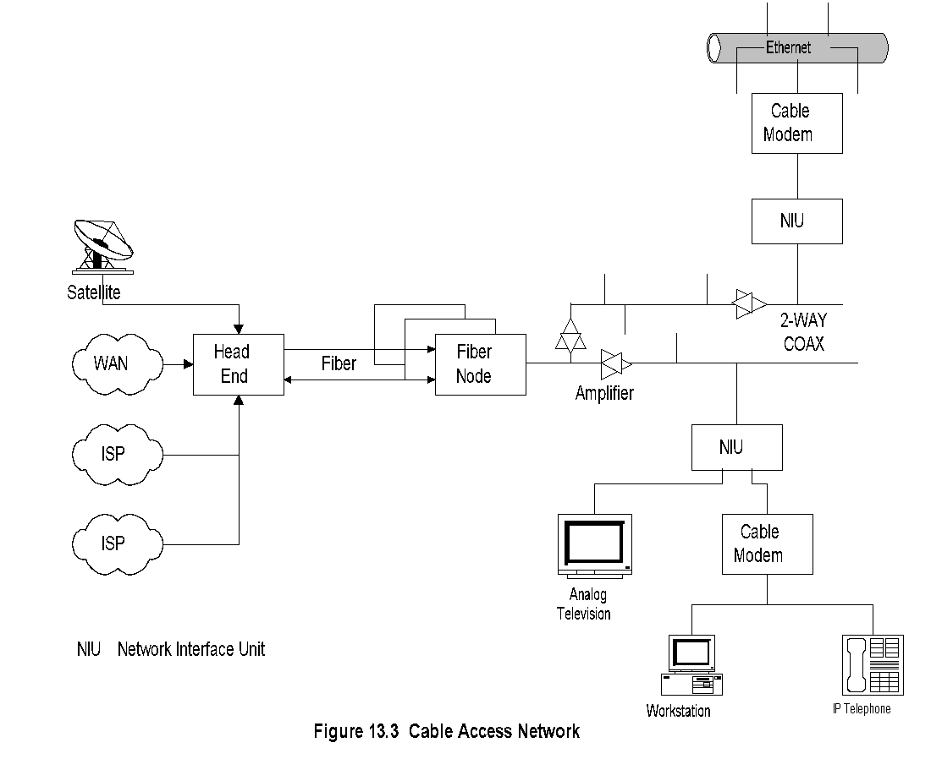
Cable Access Network
Chapter 13 Broadband Network Management: Wired and Optical Access Networks
HFC (Hybrid Fiber Coaxial)/cable modem (CM)
CM technology, also known as HFC technology, is based on existing cable television (cable TV or CATV) technology. Originally, cable TV systems were built on coaxial cable facilities from the head end of the MSO to the customer premises and used a tree structure. the signal is brought to a fiber node via a pair of optical fibers and then distributed via a coaxial cable to the customer premises.
In Figure 13.3. At the head end, signals from various sources, such as traditional satellite services, analog and digital services using WAN, Internet service provider (ISP) services using a private backbone network, and voice-over-IP service are multiplexed and up-converted from an electrical (radio frequency (RF)) to an optical signal. Communication is one way on the optical fiber. There is a pair of optical fibers from the head end to the fiber node, each carrying one-way traffic in the opposite direction. The optical signal is down-converted to an RF at the fiber node and travels over the coaxial cable in a duplex mode.
The signal that goes from head end to the customer premises is called the downstream signal or the forward path signal, and the signal going from the customer premises to the head end is called the upstream signal or the reverse path signal.
The coaxial cable is a shared access medium and is designed to carry signals up to tens of kilometers. The signal is amplified on the way in both directions, as shown in Figure 1 3.3.
At the customer premises there is a network interface unit (NIU), also referred to as network interface device (NID), which is the demarcation point between the customer network and the service provider network. The analog signal is split at the NIU.
The TV signal is directed to the TV and the data to the CM. The CM converts the digitally modulated analog carrier signal to an Ethernet output feeding a PC or an IP telephone either directly or using a home distribution network, such as a LAN.
Notes
Head end:
Signals from multiple sources multiplexed
Frequency conversion for local signal
Traffic Flow:
Downstream: Head end to NIU
Upstream: NIU to head end
Network interface device (NID) / unit (NIU): Demarcation point between customer network and service provider networks
Cable modem: RF Ethernet, voice-over-IP, and video
Notes:
Chapter 13
*

Slide 7
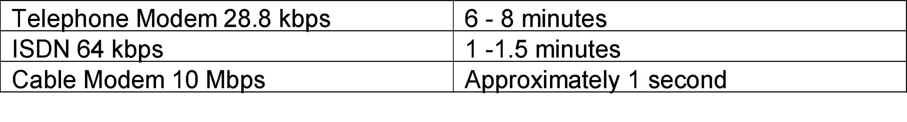
Comparative Speeds
Chapter 13 Broadband Network Management: Wired and Optical Access Networks
HFC (Hybrid Fiber Coaxial)/cable modem (CM)
The broadband cable access system with the CM can process data at a much faster rate than a conventional telephone modem or integrated services digital network (ISDN).
A typical comparative data transmission rate to transmit a single 500 kilobyte message is shown in Table 13.1.
HFC technology is based on
HFC transmission medium and mode;
CM at customer premises;
cable modem termination system (CMTS) at the head end; and
radio-frequency spread-spectrum technique to carry multiple signals over HFC to handle multimedia services of telephony (voice), television (video), and computer communication (data).
Table13.1 Comparative Data Transmission Speeds
Notes
The fiber node is connected to households via a multipoint coaxial cable. As signals arc attenuated and dispersed (with frequency), there are amplifiers inserted in the coaxial cables. Since the coaxial cable supports traffic in both directions, in contrast to the fiber that supports one-way, the amplifiers have to be two-way amplifiers, as shown in Figure 13.3.Amplifiers enable coaxial cable systems to be extended to tens of miles. The last section of the HFC plant consists of the section from the coax running along the street to the NIU in the house, referred to as "tap-to-TV" in CATV.

Slide 8
Cable Access Network Technology
Chapter 13 Broadband Network Management: Wired and Optical Access Networks
Broadband 2-way cable access network
Asymmetric bandwidth allocation for 2-way communication
Transmission Mode
Downstream: TDM broadcast mode
Upstream: TDMA / S-CDMA
RF spread-spectrum that carries multiple signals over HFC
RF spectrum allocation to carry multimedia services - voice, video, and data
Notes

Slide 9
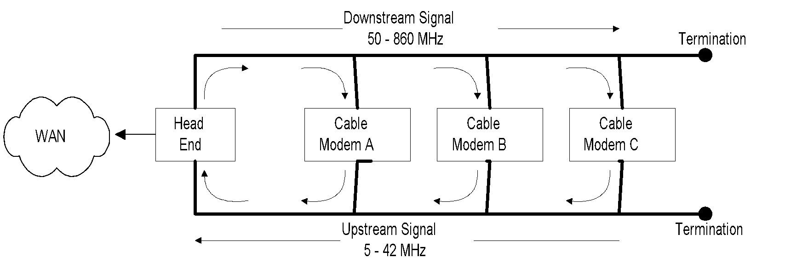
Cable Access Network
Chapter 13 Broadband Network Management: Wired and Optical Access Networks
Figure 13.4 shows the architecture of several CMs communicating with each other on a coaxial cable. Although the modems share a common coaxial cable to communicate in both directions, the figure shows the downstream (forward) and upstream (reverse) paths separated to represent the concept clearly.
The downstream and upstream paths are separated in the frequency spectrum, downstream signals 50-860 MHz and upstream signals 5-42 MHz
The downstream bandwidth of a channel is 6 MHz, while the upstream bandwidth is variable based on implementation. It ranges from 200 kHz to 3.2 MHz.
CMs receive the signal in the downstream signal band and transmit in the upstream signal band.
Let us trace the path of Cable Modem B sending a message to Cable Modem A. The message first goes past Cable Modem A (because A cannot pick up the signal from the bottom path in the figure) to the head end, where it is converted to the downstream band frequency and retransmitted. Cable Modem A then sees the message addressed to it from B coming in the downstream (from the top in the figure) and picks it up from the medium. If the message is to be transmitted outside the cable access network, the head end, acting as either a bridge or a router, redirects it appropriately.
Information is carried in the coaxial cable in a shared mode. The unique address and other security features protect the privacy of information for each, as the information can be detected and decoded only by the intended user.
Figure 13.4 Two-way Transmission in a Coaxial Cable
Notes
Single physical medium, 2 logical data streams
Downstream 6 MHz / 8 MHz channels
Upstream Variable speed channels 160 kbps to 5.2 Mbps
Downstream TDM broadcast mode
Upstream TDMA in DOCSIS 1.0 and 1.1
Upstream S-CDMA in DOCSIS 2.0

Slide 10
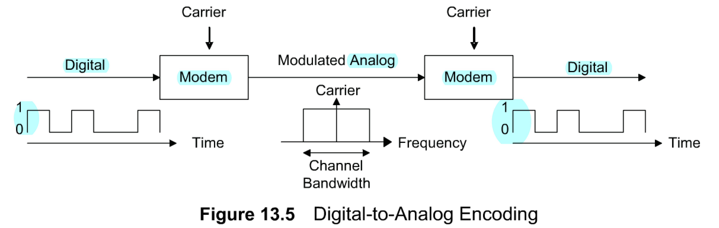
Digital-to-Analog Encoding
Chapter 13 Broadband Network Management: Wired and Optical Access Networks
The CM modulates and demodulates the digital signal from the customer's equipment to the RF signal that is carried on the cable.
There are three modes of modulation schemes. They are amplitude shift keying (ASK), frequency shift keying (FSK), and phase shift keying (PSK).
Variations and combinations of these schemes are used in CM technology Of these, the more common modulation techniques used are quadrature phase shift keying (QPSK) and quadrature amplitude modulation (QAM).
Figure 13.5 shows the basic concept. A digital signal, for example from a computer, is converted to an analog signal by the modem, in our case a CM. The converted analog signal modulates an RF carrier.
The modulated signal occupies a band of frequencies around the carrier frequency, shown as the channel bandwidth. For example, if the digital signal in Figure 13.5 varies at a rate of 1 Mbps, alternating between 0 and 1,its baseband is 1 MHz. It is frequency modulated with a carrier frequency of 100 MHz. The modulated RF signal will have a carrier frequency of 1 00 MHz and a channel bandwidth of 1 MHz. At the receiving end, the receiving modem converts the signal back to the original digital format.
We should clearly understand telecommunication transmission terminology used in managing and evaluating modems. They are bit rate, baud rate, carrier frequency, and bandwidth.
The bit rate is the number of bits per second that traverses the medium.
The baud rate is the signal units (symbols) per second.
The bit rate is baud rate times the number of bits per symbol.
The input signal could also be quantized into multiple levels, for example, into four levels (22). We would then need two bits to represent each signal unit (00, 01, 10, and 11).
Information is carried as a digital RF signal by modulating the baseband signal by the RF carrier. For example, in the ASK method, the carrier frequency is turned on and off for each bit representing 1 and 0.
Notes
bit rate
symbol (baud) rate
number of levels n = 2^{k}; k.. number of bits per symbol
bit rate = symbol rate x k

Slide 11
Modulation Schemes
Chapter 13 Broadband Network Management: Wired and Optical Access Networks
Basic modulation techniques
ASK (Amplitude Shift Keying)
FSK (Frequency Shift Keying)
PSK (Phase Shift Keying)
Cable technology uses
QPSK (Quadrature Phase Shift Keying)
QAM (Quadrature Amplitude Modulation)
Notes
QPSK Quadrature phase shift keying
Four levels ( 00, 01, 10, 11)
Relatively insensitive to noise
Used for low-band upstream
8 MHz channel: 8x2 = 16 Mbps
QAM Quadrature amplitude modulation (not 4-levels)
Combination of AM and PM
16-QAM = 8 PM x 2 AM or 4 PM x 4 AM
Used for higher-band downstream
8 MHz channel 8x4=32 Mbps

Slide 12
Cable Modem
Chapter 13 Broadband Network Management: Wired and Optical Access Networks
Table 13.2 Cable Modem Speeds
Version | DOCSIS |  | EuroDOCSIS
 | Downstream Mbit/s | Upstream Mbit/s | Downstream Mbit/s | Upstream Mbit/s
1.x | 42.88 (38) | 10.24 (9) Mbit/s | 55.62 (50) | 10.24 (9)
2.0 | 42.88 (38) | 30.72 (27) | 55.62 (50) | 30.72 (27)
3.0 4 channel | +171.52 (+152) | +122.88 (+108) | +222.48 (+200) | +122.88 (+108)
3.0 8 channel | +343.04 (+304) | +122.88 (+108) | +444.96 (+400) | +122.88 (+108)
Notes
HFC uses tree topology
Downstream in broadcast mode
Upstream transmission by cable modem coordinated by head end
Data-over-cable service specifications (DOCSIS) for cable modem ensures interoperability
One-way cable modem uses telco-return
Network Management: Principles and Practice
© Mani Subramanian 2010
*

Slide 13
Functions of Cable Modem Termination System
Chapter 13 Broadband Network Management: Wired and Optical Access Networks
Equipment at the head end
All cable modems terminated on the head end
Gateway to the external network
Multiplexes and demultiplexes signals
Frequency converts upstream to downstream signals
Can be configured either as a bridge or router
Notes
Network Management: Principles and Practice
© Mani Subramanian 2010
*

Slide 14
HFC Plant
Chapter 13 Broadband Network Management: Wired and Optical Access Networks
Multiple fiber pairs run from head end to fiber node; each pair carries 2 one-way signals
Head end converts all (telephony, digital video, data, and analog video) signals to optical carrier to transmit on the fiber
Houses are connected from fiber node via coaxial cables
Coaxial cable is in tree topology and carries 2-way signal
Amplifiers on the coaxial cable have 2-way amplifiers that amplify the signals in both directions
Drop from coaxial cable to NID (also called NIU) - called “Tap-to-TV” in CATV
Notes
Network Management: Principles and Practice
© Mani Subramanian 2010
*

Slide 15
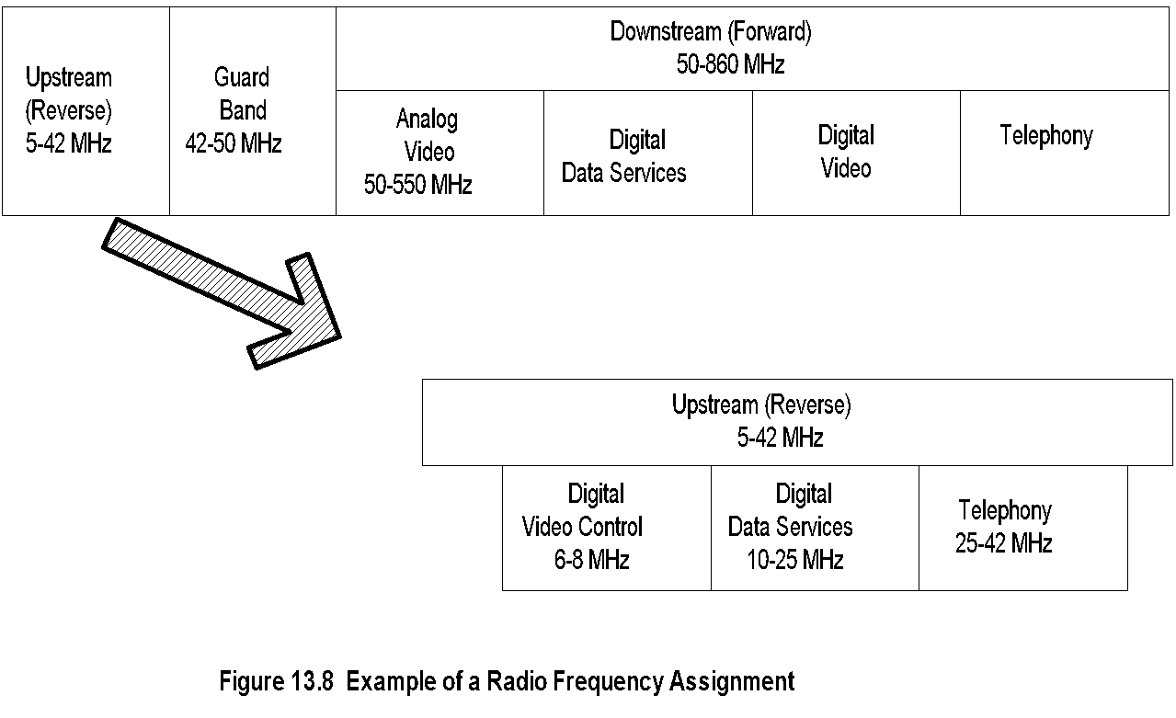
RF Spectrum
Chapter 13 Broadband Network Management: Wired and Optical Access Networks
Notes
Network Management: Principles and Practice
© Mani Subramanian 2010
*

Slide 16
Data-over-Cable Standards
Chapter 13 Broadband Network Management: Wired and Optical Access Networks
Standards driven by CableLabs
Two sets of standards to achieve interoperability
DOCSIS (Data-Over-Cable Interface Specifications)
DOCSIS 1.0
DOCSIS 1.1
DOCISS 2.0
DOCISS 3.0
IETF RFCs on MIBs
CableLabs Projects
Notes
Open Cable: Specifies customer device, Hardware and software
Packet Cable: Interoperable specifications for multimode real-time devices
Cable Home: Interface specifications for extending DOCSIS services to home
Network Management: Principles and Practice
© Mani Subramanian 2010
*

Slide 17
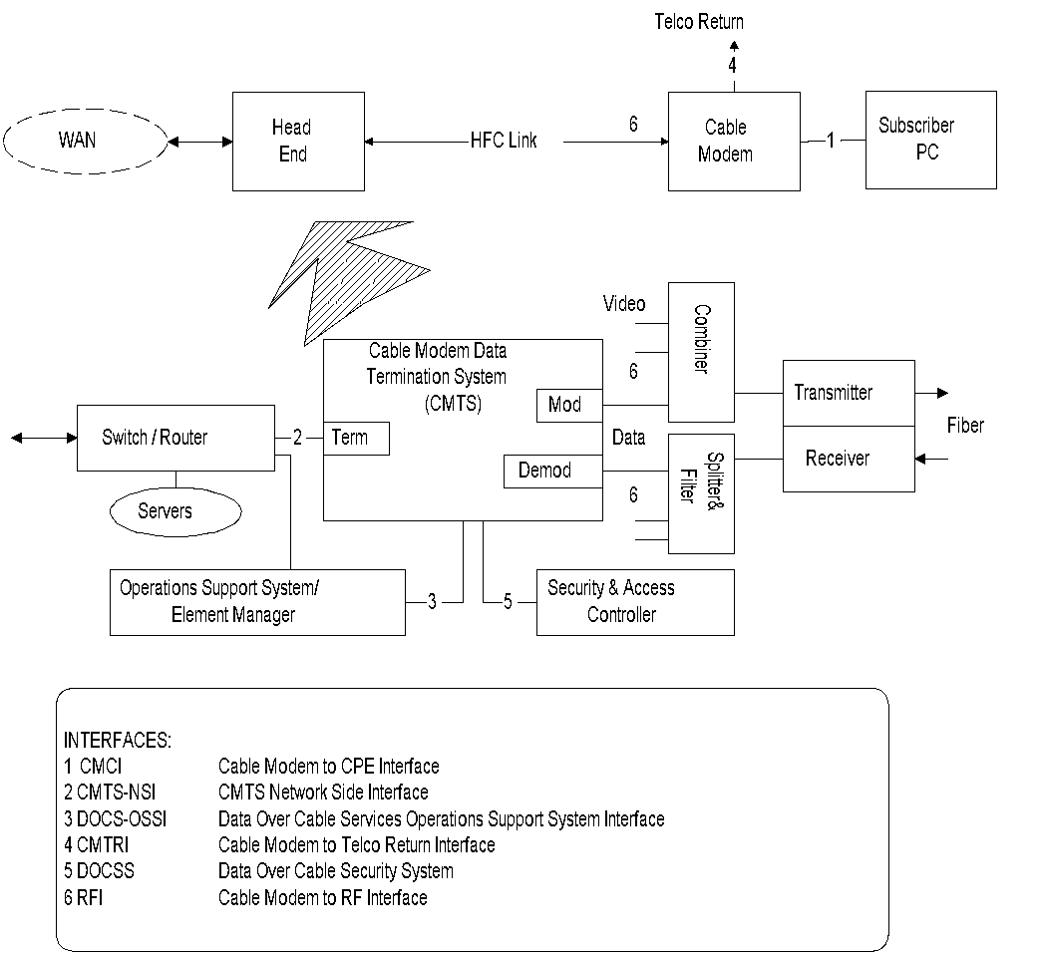
DOCS Reference Architecture
Chapter 13 Broadband Network Management: Wired and Optical Access Networks
Source: CableLabs
Figure 13.9 Data-Over-Cable System Reference Architecture
Notes
The architecture shows two-way (HFC link) and one-way (HFC link & telco return).
Network Management: Principles and Practice
© Mani Subramanian 2010
*

Slide 18
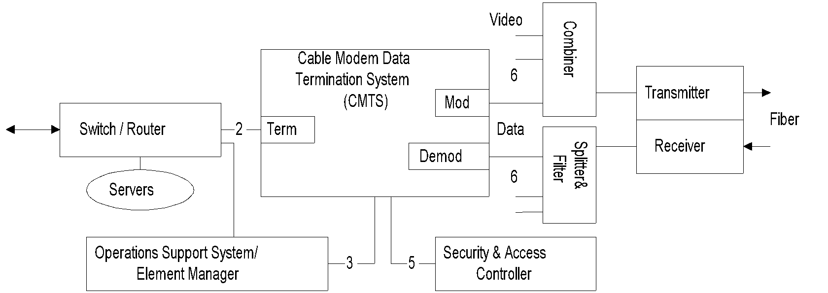
CMTS Components
Chapter 13 Broadband Network Management: Wired and Optical Access Networks
Notes
Switch / router routes the traffic between cable modems and to the external network. It interfaces to CMTS via the terminator (term).
Modulator (mod) and demodulator (demod) transform digital data from and to analog format.
Combiner and splitter and filter perform the complementary functions of mux’ing and demux’ing.
Transmitter converts the RF signals to optical carrier; receiver down-converts the optical signal.
Servers handle the applications and databases.
Security is managed by the security and access controller.
OSS and element manager perform network and service management.
Network Management: Principles and Practice
© Mani Subramanian 2010
*

Slide 19
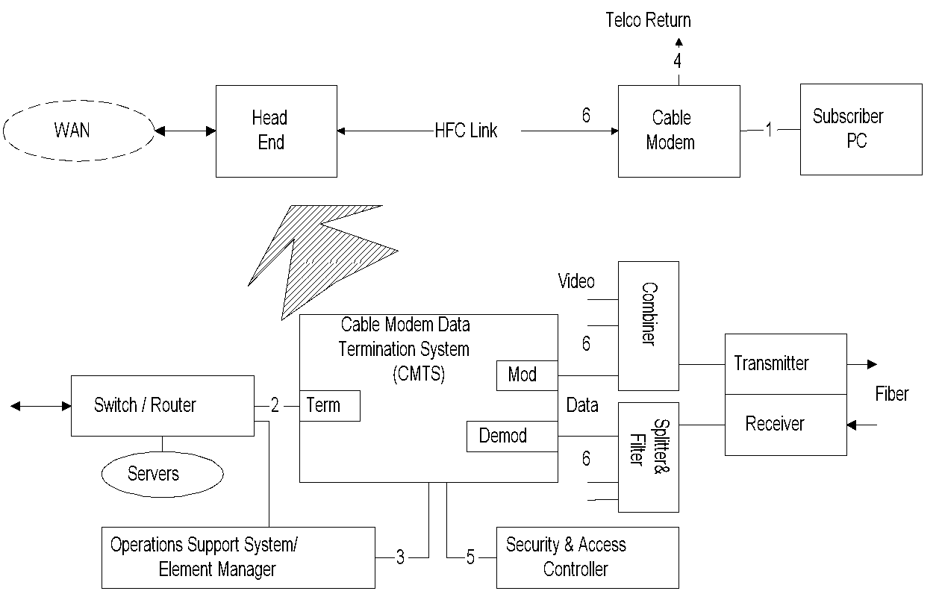
DOCS Interfaces
Chapter 13 Broadband Network Management: Wired and Optical Access Networks
Notes
Three groups of interfaces:
Data interfaces
Cable modem to CPE (1)
CMTS-NSI (2)
Operations support systems and telco-return
OSS (3)
Telco-return (4)
RF and security
DOCS security system (5)
RF interface (6)
Network Management: Principles and Practice
© Mani Subramanian 2010
*

Slide 20
HFC Management: Challenges
Chapter 13 Broadband Network Management: Wired and Optical Access Networks
More complex than either computer network or telecommunication network
Involves both physical and data layers
Multiple physical facilities
Legacy cable system
Multimedia service
RF spectrum management
Service and business management important for MSOs and customer
Shared media impacts security and bandwidth
Security and privacy of home network
Notes
Network Management: Principles and Practice
© Mani Subramanian 2010
*

Slide 21
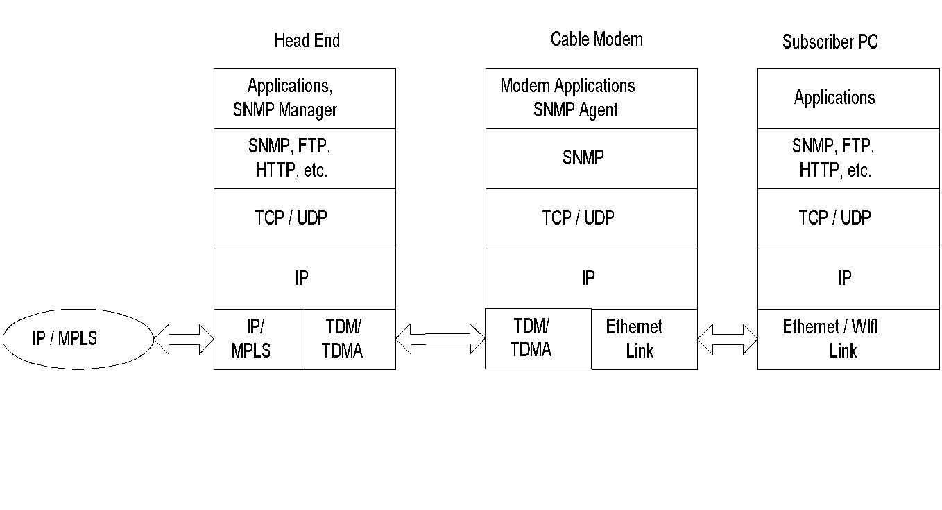
HFC Protocol Architecture
Chapter 13 Broadband Network Management: Wired and Optical Access Networks
Figure 13.10 Protocol-Layer Architecture in a Cable Access Network System
Notes
Head end has both NM applications and manager
Cable modems have SNMP agents
NMS can be regionalized; then, head ends could behave as RMONs
Network Management: Principles and Practice
© Mani Subramanian 2010
*

Slide 22
HFC / CM Management
Chapter 13 Broadband Network Management: Wired and Optical Access Networks
Cable modem management
CMTS management
HFC link management
RF spectrum management
Notes
Network Management: Principles and Practice
© Mani Subramanian 2010
*

Slide 23
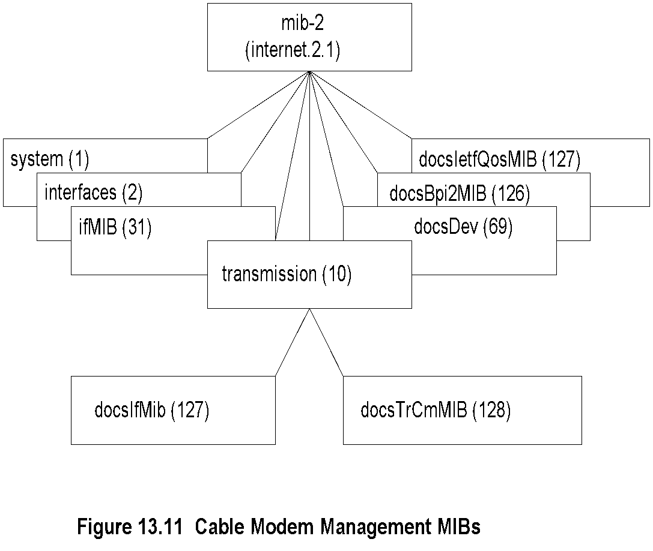
CM Management MIBs
Chapter 13 Broadband Network Management: Wired and Optical Access Networks
Notes
Three categories of MIBs
Standard MIBs:
system, interfaces, ifMIB
CM and CMTS interfaces
docIfMIB .. RF Interfaces in CM and CMTS, base line privacy and QoS
docsTrCmMIB .. telephony-return interface
CM and CMTS objects
docsDev MIB
Network Management: Principles and Practice
© Mani Subramanian 2010
*

Slide 24
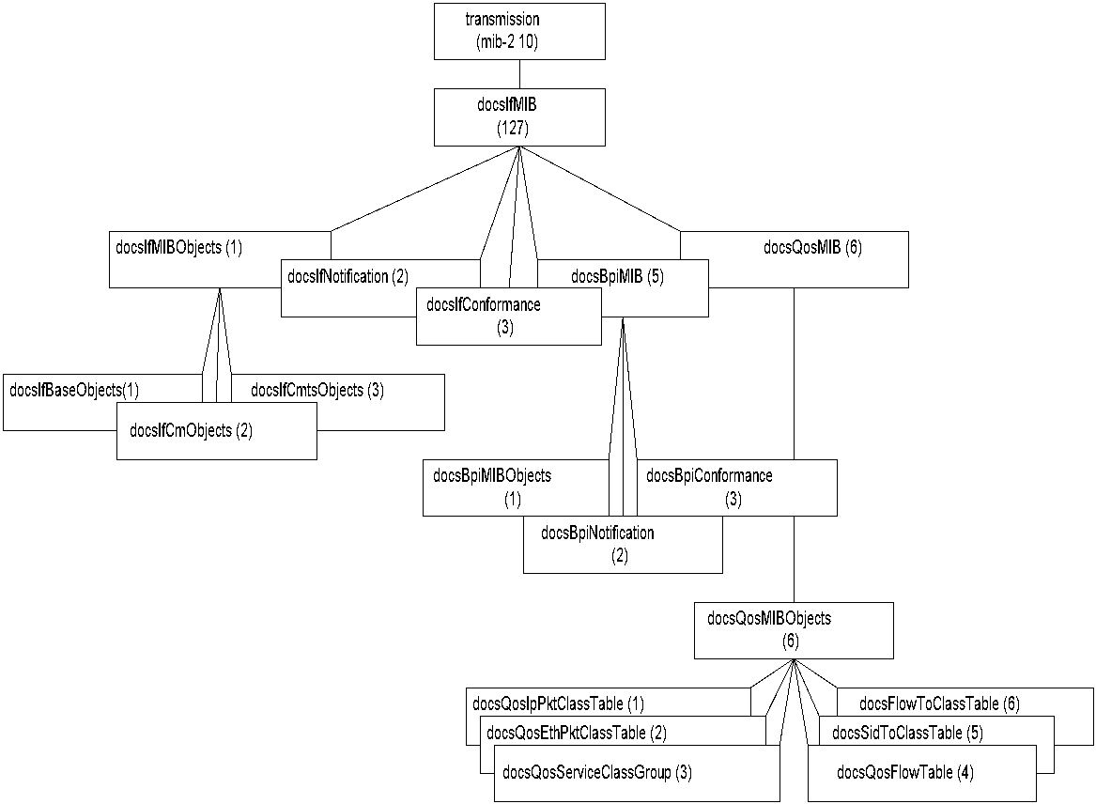
DOCS Interface MIB
Chapter 13 Broadband Network Management: Wired and Optical Access Networks
Figure 13.12 DOCS Interface MIB
Notes
docsIfMIB supplements standard SNMP interfaces MIB
Covers:
CM and CMTS objects docsIfMIBObjects
Baseline privacy MIB docsBpiMIB: Security &
Privacy
QoS MIB docsQosMIB: CM and CMTS QoS
Network Management: Principles and Practice
© Mani Subramanian 2010
*

Slide 25
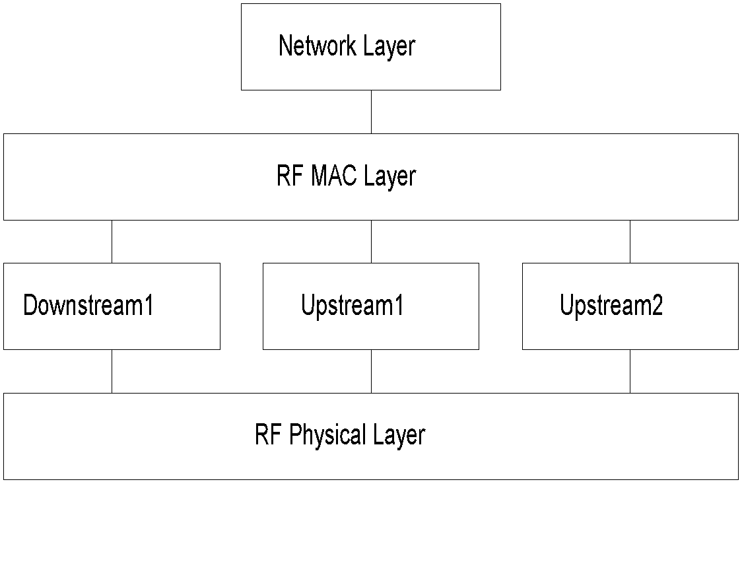
RF MAC Interface
Chapter 13 Broadband Network Management: Wired and Optical Access Networks
Figure 13.13 RF MAC Interface
Notes
Multiple RF channels upstream and downstream
Layered structure
Specified using RFC 2873 ifMIB
ifType
docsCable MAC layer 127
docsCable downstream 128
docs upstream 129
Network Management: Principles and Practice
© Mani Subramanian 2010
*

Slide 26
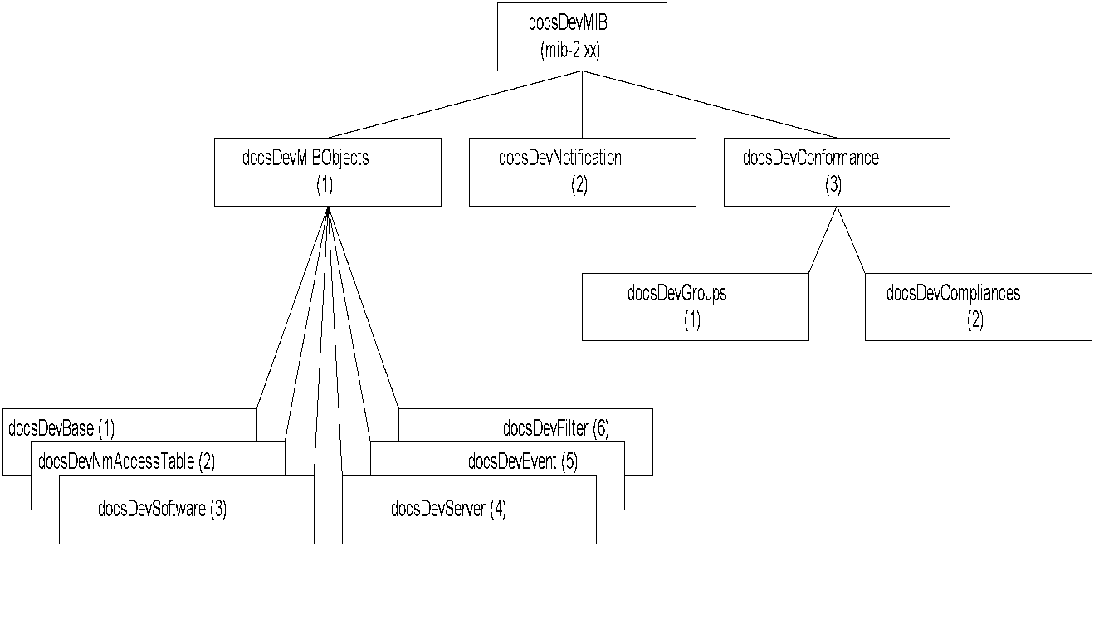
DOCS Cable Device MIB
Chapter 13 Broadband Network Management: Wired and Optical Access Networks
Figure 13.14 DOCS Cable Device MIB
Notes
Network Management: Principles and Practice
© Mani Subramanian 2010
*

Slide 27
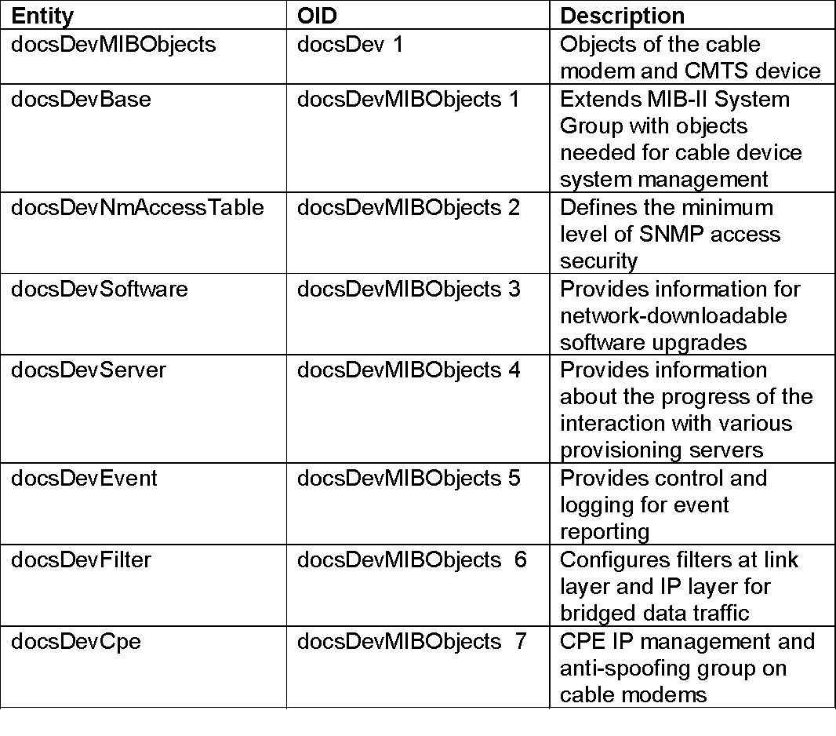
DOCS Cable Device MIB
Chapter 13 Broadband Network Management: Wired and Optical Access Networks
Table 13.6 DOCS Cable Device MIB
Notes
Network Management: Principles and Practice
© Mani Subramanian 2010
*

Slide 28
Link and Spectrum Management
Chapter 13 Broadband Network Management: Wired and Optical Access Networks
HFC Link Management
Signal strength critical
Requires continuous monitoring of amplifiers using transponders (CheetahNet)
Legacy system requires proxy server
RF Spectrum Management
Allocation of spectrum for services - upstream and downstream
Frequency agility management
Notes
Network Management: Principles and Practice
© Mani Subramanian 2010
*

Slide 29
DOCSIS 1.0 / 1.1
Chapter 13 Broadband Network Management: Wired and Optical Access Networks
Key differences between DOCSIS 1.0 and 1.1
Quality of Service – 8 levels
Dynamic Services
Fragmentation of upstream packet per CM basis
Concatenation of packets
Payload Header Suppression of repeated header
IP Multicast using IGMP
CM Authentication
SNMPv3 security
View-based access control and management (VACM)
CM Account Management
Fault Management
Secure Software
Notes
Network Management: Principles and Practice
© Mani Subramanian 2010
*

Slide 30
DOCSIS 2.0 and 3.0
Chapter 13 Broadband Network Management: Wired and Optical Access Networks
DOCSIS 2.0
Enhancements on improving the performance of upstream traffic
Efficient modulation techniques using two protocols:
Synchronous CDMA (code division multiple access)
Asynchronous TDMA (time division multiple access)
DOCSIS 3.0
Introduction of IPv6 management
Enhanced OSS interface
Accounting management – Usage-based billing:
SAMIS (Subscriber Account Management Interface Specification)
IP Multicast
Channel bonding
Notes
Network Management: Principles and Practice
© Mani Subramanian 2010
*

Slide 31
DOCSIS Documentation (Management Related)
Chapter 13 Broadband Network Management: Wired and Optical Access Networks
SP-CMCI-I10-050408 | Cable Modem to Customer Premises equipment Interface (CMCI) Specification
SP-CMTRI-I01-970804 | Cable Modem Telephony return Interface Specification
CM-SP-L2VPN-I08-080522 SP-CMTS-NSI-I01-960702 | Cable Modem Termination System - network side Interface specification
SP-RFIv1-I01-990311 CM-SP-DRFI-I06-080215 | RF Interface Specification
CM-SP-BPI+-I12-050812 | Baseline Privacy Interface Specification
CM-SP-OSSIv1.1-C01-050907 CM-SP-OSSIv2.0-I09-050812 CM-SP-M-OSSI-I07-071206 CM-SP-OSSIv3.0-I07-080522 | OSS Interface Specifications
RFC 4639 | Cable Device MIB
RFC 4547 | Event Notification MIB
RFC 4546 | RF Interface MIB
RFC 3083 RFC 4131 | Baseline Privacy MIB
draft-ietf-ipcdn-qos-mib-07.txt RFC 4323 | Quality of Service MIB
draft-ietf-ipcdn-tri-mib-00.txt, July 30, 1998 | Telephony-return interface MIB for Cable Modems and CMTS
RFC 4036 | CMTS for Subscriber Management
Network Management: Principles and Practice
© Mani Subramanian 2010
*

Slide 32
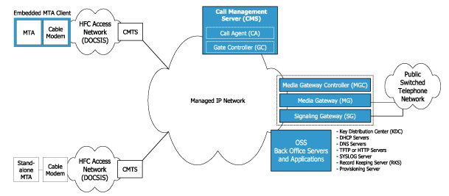
Packet Cable VoIP
Chapter 13 Broadband Network Management: Wired and Optical Access Networks
Notes
Packet Cable defines a platform to deliver IP services over DOCSIS
Network Management: Principles and Practice
© Mani Subramanian 2010
*

Slide 33
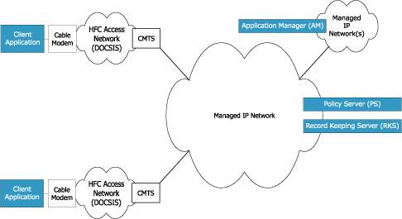
Packet Cable Multimedia
Chapter 13 Broadband Network Management: Wired and Optical Access Networks
Notes
Platform for multimedia over DOCSIS access network
Application manager requests QoS on behalf of clients
Policy managers authorize and commit QoS requests
Network Management: Principles and Practice
© Mani Subramanian 2010
*

Slide 34
Digital Subscriber Line (DSL) Access Networks
Chapter 13 Broadband Network Management: Wired and Optical Access Networks

Slide 35
DSL Access Technology
Chapter 13 Broadband Network Management: Wired and Optical Access Networks
Why is DSL attractive?
Shannon limit of data rate is 30,000 bps (3-KHz, 30 dB S/N channel)
Digital transmission over loop (DSL) improves data rate
8-15 Mbps downstream
0.8-1.5 Mbps upstream
Limit on distance: max to 18,000 feet
Notes

Slide 36
DSL Limitations
Chapter 13 Broadband Network Management: Wired and Optical Access Networks
Loop conditions with no direct copper to the house
Loaded coils in loop (used to increase analog distance) cannot carry digital signal
Modern subdivisions have fiber to the neighborhood or curb with digital mux
Operating company inventory dated (administrative issue)
Notes
Symmetric high data rate digital subscriber line (SHDSL) operates at Tl or El data rate in a duplex mode with two pairs of wires [RFC 3276], The duplex mode is defined as two-way communication with the same speed in both directions. Symmetric HDSL operates with two pairs, one for each direction. SHDSL typically operates at rates from 256 Kb/s to 6 Mb/s upstream and downstream.
VDSL operates asymmetrically. As in ADSL, the downstream signal has a larger bandwidth and is at the high end of the spectrum, whereas the upstream is at the lower end of the spectrum with a lower bandwidth for the signals. VDSL 2 has long- and short-range implementation, the former being asymmetrical and the latter being symmetrical.

Slide 37
xDSL Technologies
Chapter 13 Broadband Network Management: Wired and Optical Access Networks
Table 13.8 DSL Technologies
Name | Meaning | Max Data Rate* | Mode | Cable | Applications
ADSL / ADSL2 / ADSL2+ | Asymmetric Digital Subscriber Line | 7/12/24 Mbps 0.8/1/1 Mbps | Down Up | 1-pair | Most common type
SHDSL | Symmetric High data rate DSL | 5.6 Mbps | Duplex Duplex | 2-pair | Business Connections
VDSL 1 Km | Very high data rate Digital Subscriber Line | 55 Mbps 15 Mbps | Down Up | 2-pair | Triple Play (No QoS)
VDSL2- Long Reach 3 Km | Very high data rate Digital Subscriber Line | 55 Mbps 30 Mbps | Down Up | 2-pair | Triple Play
VDSL Short Reach 500 m | Very high data rate Digital Subscriber Line | 100 Mbps 100 Mbps | Down Up | 2-pair | Triple Play
* Max Data Rate as per Broadband Forum
Notes
Basic asymmetric digital subscriber line (ADSL) architecture consists of an unloaded pair(s) of wires connected between a transceiver unit at the central office and a transceiver unit at the customer premises.
This transceiver multiplexes and demultiplexes voice and data and converts the signal to the format suitable for transmission on the ADSL link.
Table 13.8 [Broadband Forum] shows various forms of DSL and their characteristics. ADSL 2 and ADSL 2+ are enhancements to ADSL.

Slide 38
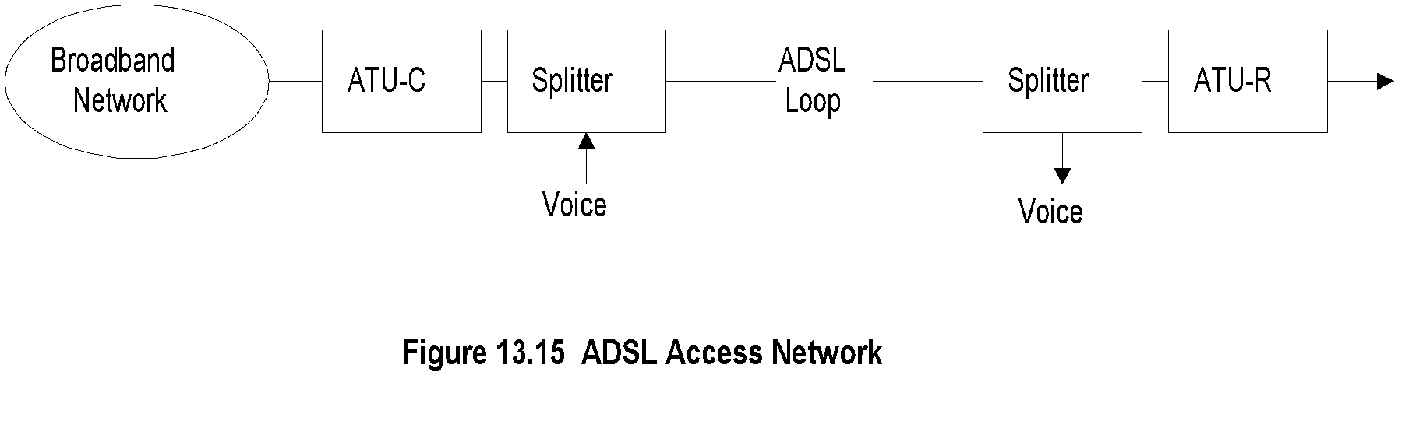
ADSL Network
Chapter 13 Broadband Network Management: Wired and Optical Access Networks
the asymmetric digital subscriber line (ADSL) is the technology that is being deployed now in most of the world. A simplified access network using ADSL is shown in Figure 13.15 and consists of an ADSL transmission unit (ATU) and splitter at each end of the ADSL line.
The ATU acronym has also been expanded in print as the ADSL transceiver unit as well as the ADSL terminating Unit
The ATU at the central office is ATU-C and the one at the customer residence is ATU-R. The ATU is also called the ADSL modem.
The data and video signal from the broadband network is converted to an analog signal by the ATU-C and multiplexed and demultiplexed.
The splitter at the central office combines the plain old telephone service (POTS) voice signal and the broadband signal. The reverse process occurs at the splitter and ATU-R at the customer premises (residence). There are modems available that embed the splitter and thus eliminate a separate splitter at the customer site. This configuration is referred to as ADSL-Lite, also known as GLite.
Notes
ADSL .. Asymmetric Digital Subscriber Line
ATU-C ADSL transmission unit - central office
ATU-R ADSL transmission unit - remote/residence
Splitter separates voice and data

Slide 39
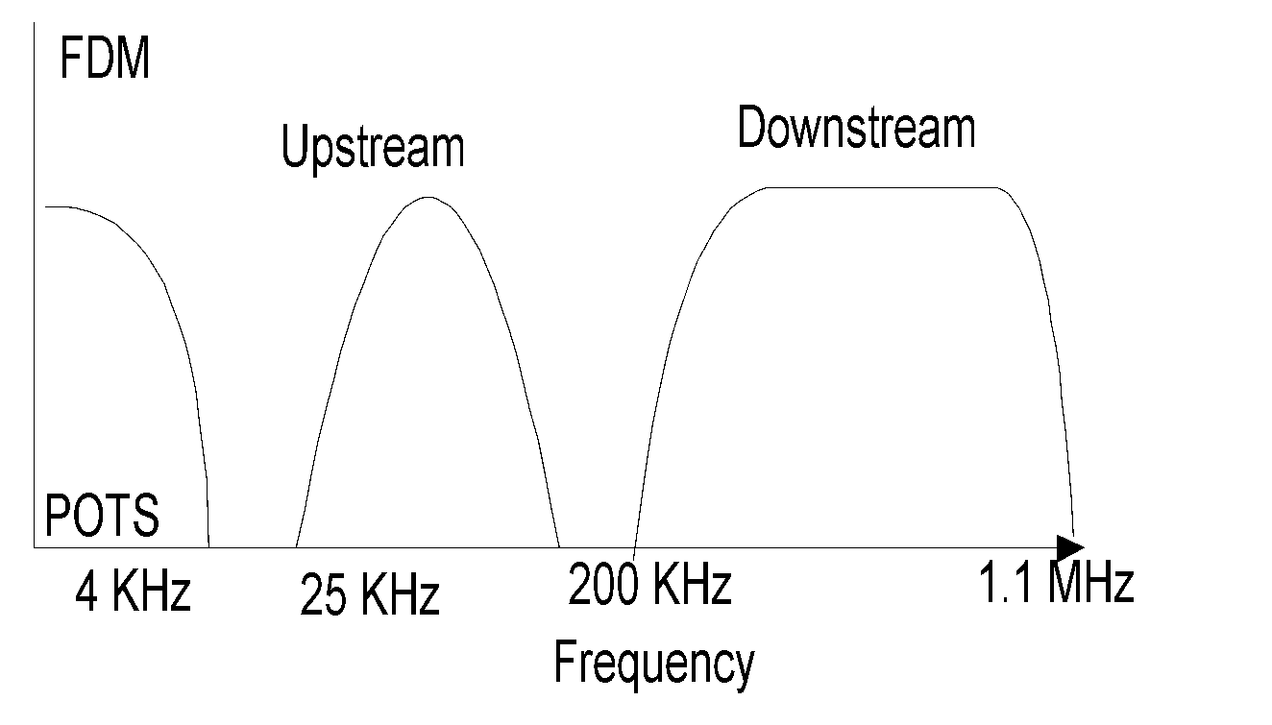
ADSL Spectrum Allocation with Guard Band
Chapter 13 Broadband Network Management: Wired and Optical Access Networks
There are two schemes for separating the upstream and downstream frequency bands: frequency division multiplexing (FDM) or echo cancellation.
In FDM, after separating the upstream and downstream bands, each band is then divided into one or more high-speed channels and one or more low-speed channels.
In echo cancellation, upstream and downstream bands overlap, but are separated by a technique known as echo cancellation. Using echo cancellation, the low frequency end of the spectrum is made available for downstream, thus increasing the overall downstream spectral band.
Figure 13.16 ADSL Spectrum Allocationd (FDM)
Notes
POTS .. Plain old telephone service

Slide 40
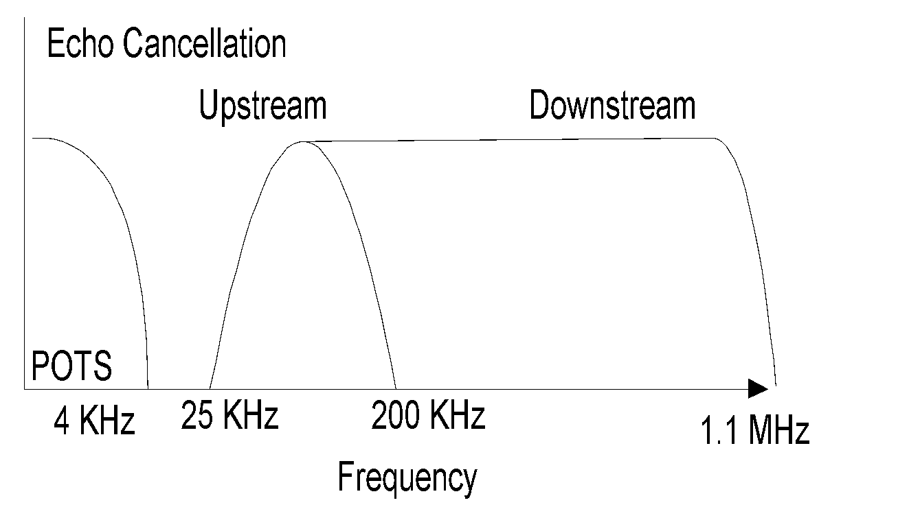
ADSL Spectrum Allocation with Echo Cancellation
Chapter 13 Broadband Network Management: Wired and Optical Access Networks
Figure 13.16 ADSL Spectrum Allocation (Echo Cancellation)
Notes
Echo cancellation separates upstream and downstream signals
Increases (low-frequency) upstream bandwidth

Slide 41
Modulation Schemes
Chapter 13 Broadband Network Management: Wired and Optical Access Networks
Carrierless amplitude phase (CAP) modulation
Discrete MultiTone modulation (DMT): 4kHz tones
Both CAP and DMT are QAM-based
DMT outperforms CAP
Higher downstream throughput > 4 times
Higher upstream throughput > 10
Rate adaptive
Ongoing active monitoring
Maximum loop variation coverage
Standard and hence interoperability
Notes
Within the upstream and downstream bands, individual channels are allocated a multiple of 4 kHz band using either the standard discrete multitone (DMT) or carrierless amplitude phase (CAP) modulation.

Slide 42
DSL / Broadband Forum
Chapter 13 Broadband Network Management: Wired and Optical Access Networks
ADSL (now Broadband) Forum is an industry consortium formed to
Achieve interoperability
Accelerate DSL implementation
Address end-to-end system operation
Security
Management
3 sets of complementary standards adopted
ITU-T standards
G.992.x
G.997.x
T1-413 (ANSI)
Forum Standards
Technical reports TR-xxx
IETF standards
RFC xxxx
Notes

Slide 43
Selected Documentation from DSL / Broadband Forum
Chapter 13 Broadband Network Management: Wired and Optical Access Networks
Table 13.9 ADSL Management Documents
TR-001 | ADSL Forum System Reference Model | May 1996
TR-005 | ADSL Network Element Mgmt | March 1998
TR-015 | CAP Line Code Specific MIB | February 1999
TR-024 | DMT Line Code Specific MIB | June 1999
TR-027 | SNMP-based ADSL LINE MIB | September 1999
TR-028 | CMIP Specification for ADSL Network Element Mgmt | May 1999
TR-066 | ADSL Network Element Mgmt (Update to TR-005) | March 2004
TR-090 | Protocol Independent Object Model for Managing Next Generation ADSL Technologies | December 2004
TR-113 | MCM Specific Managed Objects in VDSL Network Element | December 2005
TR-128 | Addendum to TR-090 | September 2006
Notes
Network Management: Principles and Practice
© Mani Subramanian 2010
*

Slide 44
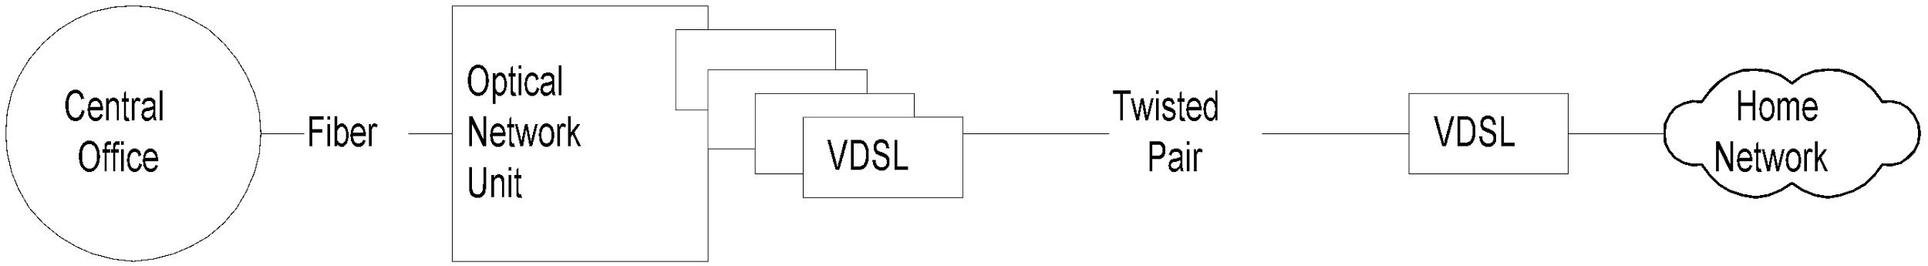
VDSL Network
Chapter 13 Broadband Network Management: Wired and Optical Access Networks
telephone companies would offer VDSL service, as shown in Figure 13.17.
This has the benefit of providing greater bandwidth.
The signal traverses the optical fiber medium from the central office to the optical network unit (ONU) in the neighborhood carrying multiple channels.
It is demultiplexed at the ONU and fed through VDSL modems and twisted-pair cable to the residence
Figure 13.17 VDSL Access Network
Notes
Used in FTTN configuration
Asymmetric band allocation (similar to ADSL)
Fiber carries multiple channels to ONU
Channels demultiplexed at ONU and carried to customer premises on multiple twisted pairs
Shorter distance of multiple twisted pairs
Higher data rate - 55.2 Mbps downstream and 2.3 Mbps upstream

Slide 45
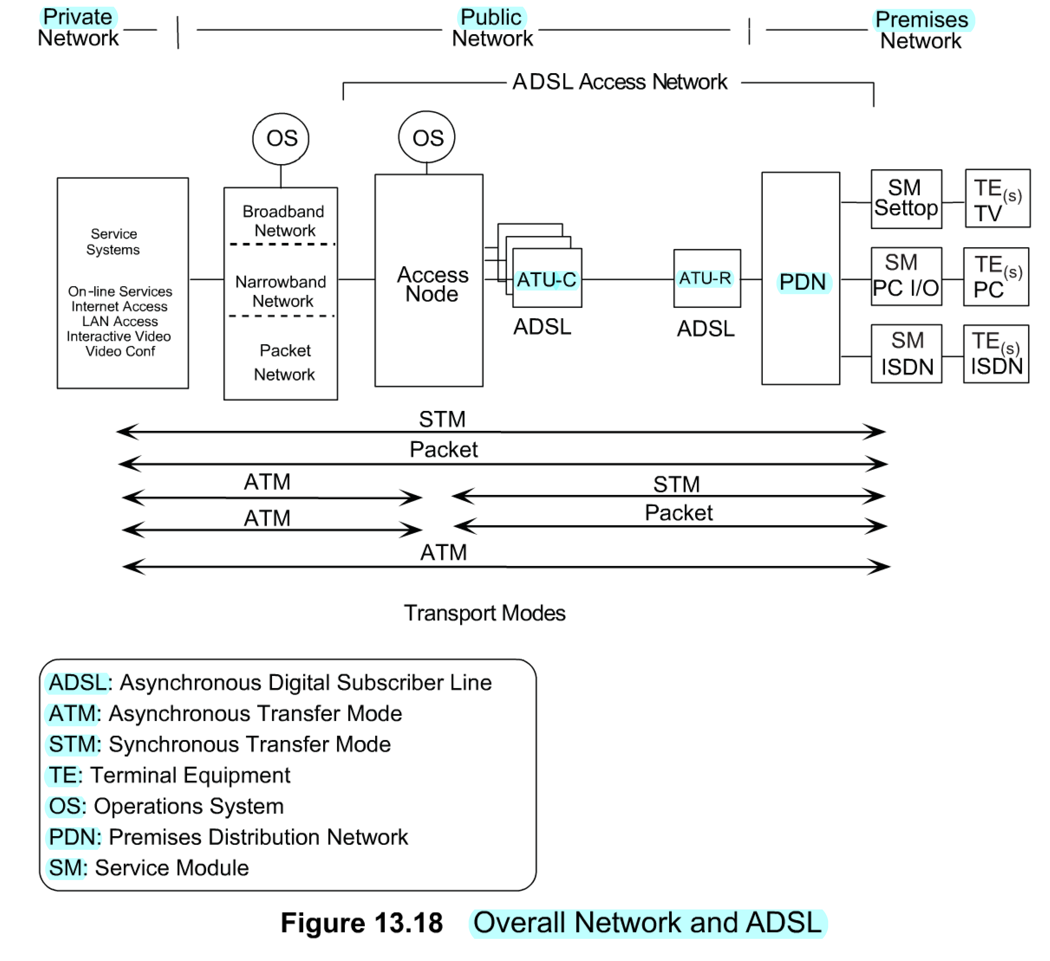
ADSL Network
Broadband Forum's view of how ADSL access network fits into the overall network for broadband services is presented in Figure 13.18. It shows the components of the overall network comprising private, public, and premises network and the role that ADSL access network plays in it.
The networking side of the service providers consists of service systems, different types of networks that are behind the access node, the operation systems (OS) that perform the operations, administration, and maintenance (OAM) of the networks and access nodes, and the ATU-Cs.
The customer premises network comprises ATU-R, premises distribution network (PDN), various service modules (SM), and terminal equipment (TE). On the bottom of Figure 13.18 are shown five transport modes that depict an evolutionary process from a primitive synchronous transfer mode (STM) to an all ATM mode.
The service systems are on a private network providing on-line services, Internet access, LAN access, interactive video, and video conference services. The private network interfaces with the public network, which is broadband (such as SONET/SDH), narrowband (such as Tl/El), or packet network (such as TP). The access node is the concentration point for broadband, narrowband data, and packet data. It is either located in the central office or a remote location such as ONU. The access node could include ATU-Cs, such as in a digital subscriber loop access multiplexer (DSLAM). The access network commences at the access node and extends up to PDN in the customer premises.
The premises network starts from the network interface at the output of ATU-R. The PDN, which is part of the home network, could be a choice of a LAN, twisted-pair cable, optical fiber or a combination of these.
SM, such as set-top boxes and ISDN, perform the terminal adaptation functions to the TE.
five
transport
modes
Notes

Slide 46
Transport Modes
Chapter 13 Broadband Network Management: Wired and Optical Access Networks
There are five transport modes presented in Figure 1 3.18.
At the top is what the ADSL Forum termed synchronous transfer mode (STM),which is the bit synchronous transmission mode. An example of this is the bit pipe such as Tl/El, ISDN, or a simple modem. In this mode, the PDN outputs strictly bits out of the SM; and the access node delivers and receives bits to and from the narrowband network.
The second transport scheme is the end-to-end packet mode such as IP packets. In this mode, SM are expected to deliver packets to the ADSL access network through PDN. This is probably one of the most common usages of the Small Office Home Office (SOHO) network. Digital data terminals are interconnected via an Ethernet LAN PDN, and packets are delivered to the ADSL access network via a router. The reverse process occurs at the access node to the network interface.
The next two transport modes are hybrid modes. Output to the network from the access node is the ATM. The SM at the premises network delivers either a bit synchronous output or a packet output.
The fifth, and last, mode of transport scheme is the end-to-end ATM, where SM put out cells instead of packets. We would expect the home network in this case to be wired with optical fiber.
Synchronous transport mode (STM)
Bit synchronous transmission (T1/E1)
End-to-end packet mode
Used for SOHO (IP packets)
ATM / STM
ATM WAN (Public network) and STM access network
ATM / Packet
ATM WAN and packet access network (IP)
End-to-end ATM
Notes

Slide 47
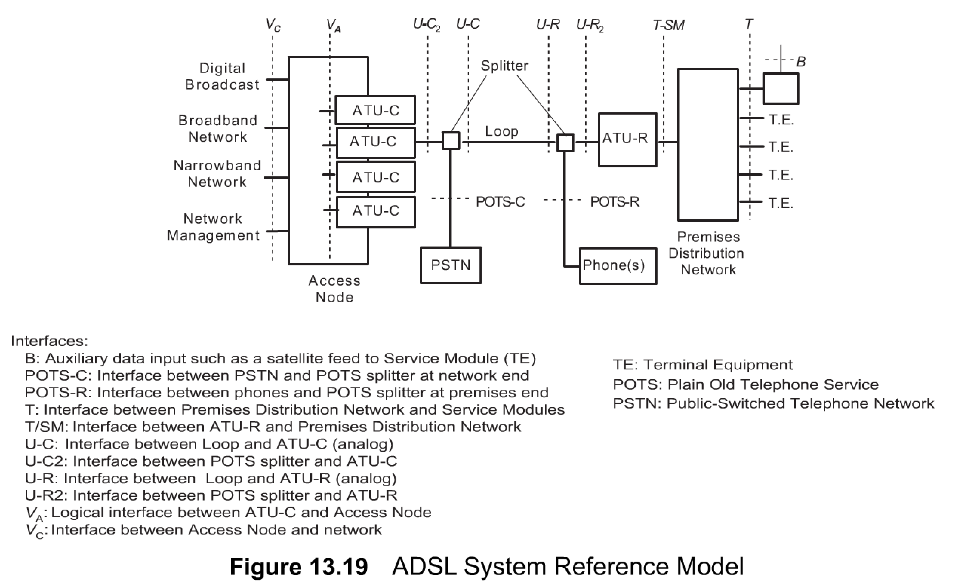
ADSL System Reference Model
Chapter 13 Broadband Network Management: Wired and Optical Access Networks
Interesting aspects of the ADSL system reference model shown in Figure 13.19 are the interfaces between components of the ADSL network and interfaces between ADSL access network and external networks.
There are five basic interfaces: V, U,T, B, and POTS.
Vc is the interface between the access node and the network and is usually a physical interface.
V_{A} is the logical interface between ATU-C and the access node.
There are several U interfaces shown in Figure 13.19. They are all off the splitters.
POTS interfaces are also from the splitters as shown. The B interface is for auxiliary data input
Notes

Slide 48
Interfaces
Chapter 13 Broadband Network Management: Wired and Optical Access Networks
An interface can have multiple physical connections
V interface
V_{C} interface between access node and external network and interfaces
U interfaces - off the splitters; Will be eliminated with ADSL-Lite
POTS interfaces – low-pass filter interfaces for POTS
T and B are customer premises network interfaces
T between PDN and service modules
B auxiliary data input (e.g., satellite feed)
Notes
ADSL-Encoding Schemes
ADSL management is dependent on the line-encoding scheme
There are two encoding schemes used in ADSL line encoding.
They are carrierless amplitude and phase (CAP) modulation and discrete multitone (DMT) technology. Both are based on the QAM scheme

Slide 49
ADSL Channeling Schemes
Chapter 13 Broadband Network Management: Wired and Optical Access Networks
There are two perspectives in discussing transport channels in an ADSL access network.
The first perspective is the traditional transport bearer channels as they are defined in ISDN.
For ADSL transport frames, there are seven "AS" bearer channels defined for the downstream signal operating in a simplex mode.
The second perspective in discussing the channels is how the signal is buffered while traversing the ADSL link.
Real-time signals, such as audio and video, use a fast buffering scheme and hence are referred to as the fast channel.
Digital data that could tolerate delay use slow buffers that are interleaved between the fast signals. The digital data channel is referred to as the interleaved channel.
ATU-C
ATU-R
Downstream bearer channels
Duplex bearer channels
ATU-C
ATU-R
Fast channel
Interleaved channel
Figure 13.20 ADSL Channeling
Notes
Transport bearer channels
Seven AS downstream channels - multiples (1-, 2-, 3- or 4-) T1 rate of 1.536 Mbps
Three LS duplex channels - 160, 384, and 576 Kbps
Buffering scheme
Fast channel: uses fast buffers for real-time data
Interleaved channel: used for non-real-time data
Both fast and interleaved channels carried on the same physical channel

Slide 50
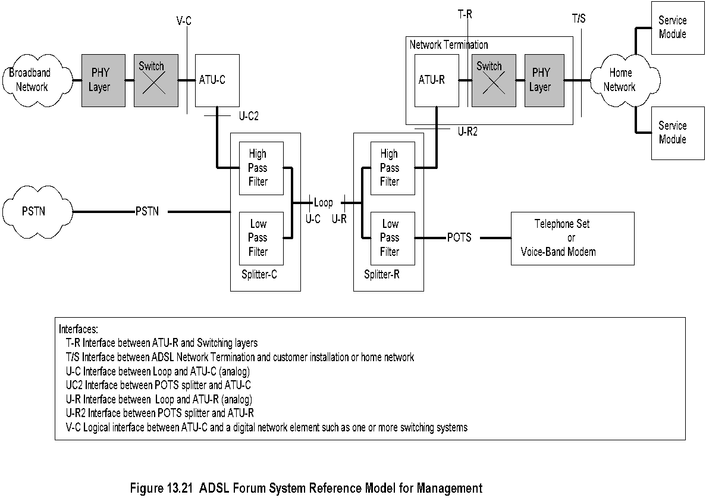
Management Reference Model
Chapter 13 Broadband Network Management: Wired and Optical Access Networks
Notes
Figure 13.21 shows the ADSL system reference model that is used in the ADSL management framework.

Slide 51
ADSL Network Management Elements
Chapter 13 Broadband Network Management: Wired and Optical Access Networks
Management of elements done across V-interface:
Management communications protocol across V-interface
Management communications protocol across U-interfaces
Parameters and operations across ATU-C
Parameters and operations across ATU-R
ATU-R side of the T interface
Notes
Note addition of physical layer and switching in the management architecture representation
Management of physical layer involves:
Physical channel
Fast channel
Interleaved channel
Management of type of line encoding
DMT
CAP

Slide 52
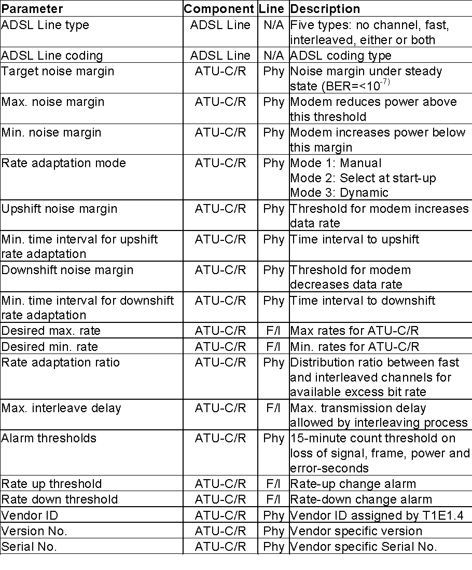
Configuration Mgmt Parameters
Chapter 13 Broadband Network Management: Wired and Optical Access Networks
Table 13.10 ADSL Configuration Management Parameters
Various parameters that need to be managed for configuration are listed in Table 13.10. The table lists the component that the parameter is associated with, as well as whether it pertains to the physical line or fast or interleaved channel. A brief description of each parameter is given in the last column.

Slide 53
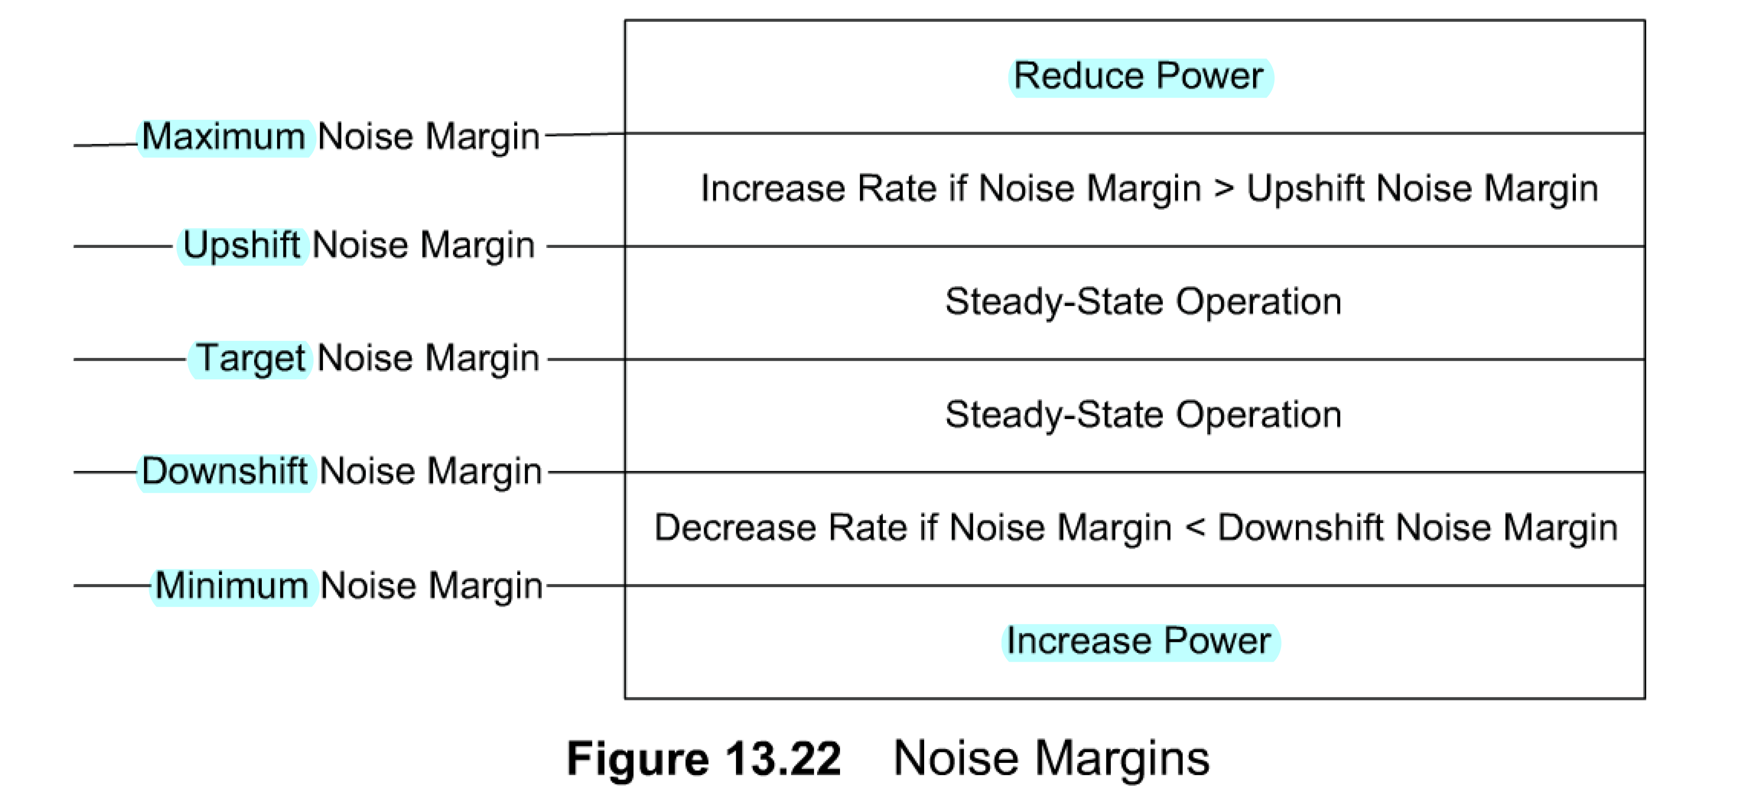
Signal Power and Data Rate Management
Chapter 13 Broadband Network Management: Wired and Optical Access Networks
There are five levels of noise margin — from the highest defined by the maximum noise margin to the lowest defined by the minimum noise margin
Some modems support rate adaptation modes.
There are three modes. Mode 1 is manual in which the rate is changed manually. In mode 2 the rate is automatically selected at start-up, but remains at that level afterwards. The last mode is mode 3 where the rate is dynamic based on the noise margin.
noise margin
Notes
Five levels of noise margin
Signal power controlled by noise margin
Data rate: Increase or decrease based on threshold margins
Data rate adaptation modes:
Manual (1),
automatic at start-up (2), and
dynamic (3)

Slide 54
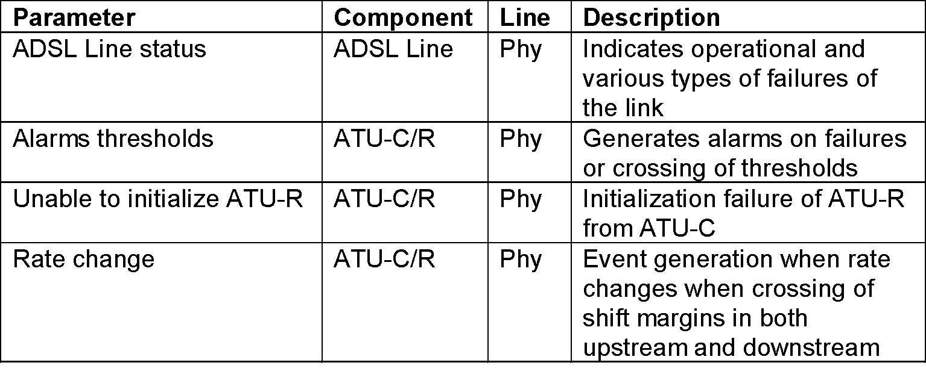
Fault Management
Chapter 13 Broadband Network Management: Wired and Optical Access Networks
Table 13.11 ADSL Fault Management Parameters
Fault management parameters are shown in Table 13.11 and should be displayed by the NMS. After the automatic indication of faults
Notes
Failure indication of physical channel by NMS
Failure indication of logical channels
Failure indication of ATU-C/R
Self-test of ATU-C/R as per T1.413
Noise margin threshold alarms
Rate change due to noise margin

Slide 55
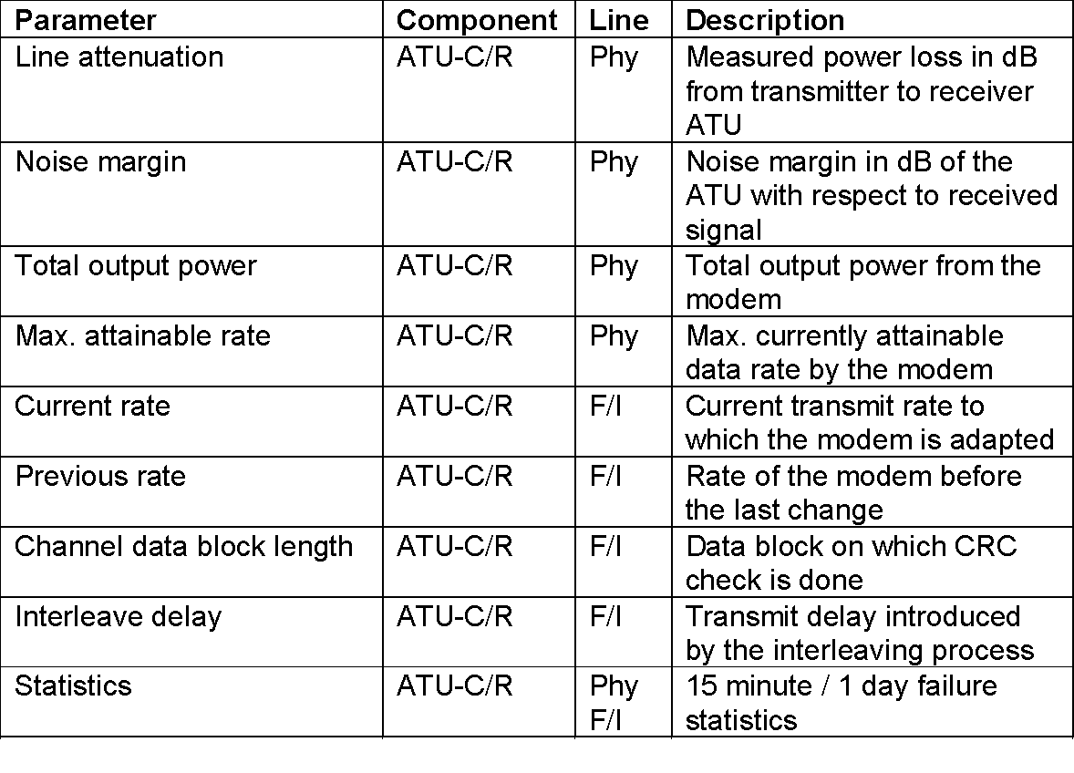
Performance Management
Chapter 13 Broadband Network Management: Wired and Optical Access Networks
Table 13.12 ADSL Performance Management Parameters
Table 13.12 shows the parameters associated with ADSL performance management.
Notes
Line attenuation
Noise margin
Output power
Data rate
Data integrity check
Interleave channel delay
Error statistics

Slide 56
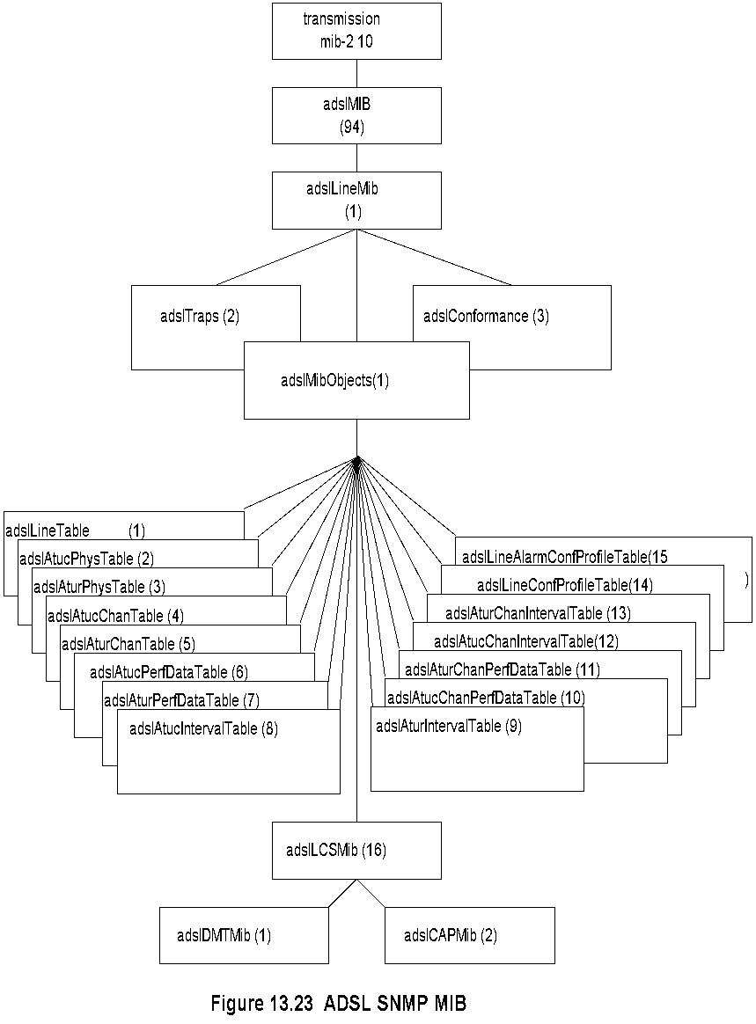
ADSL SNMP MIB
Chapter 13 Broadband Network Management: Wired and Optical Access Networks
There are both SNMP and CMIP based specifications that have been developed for ADSL. We will discuss the updated SNMP-based MIB

Slide 57
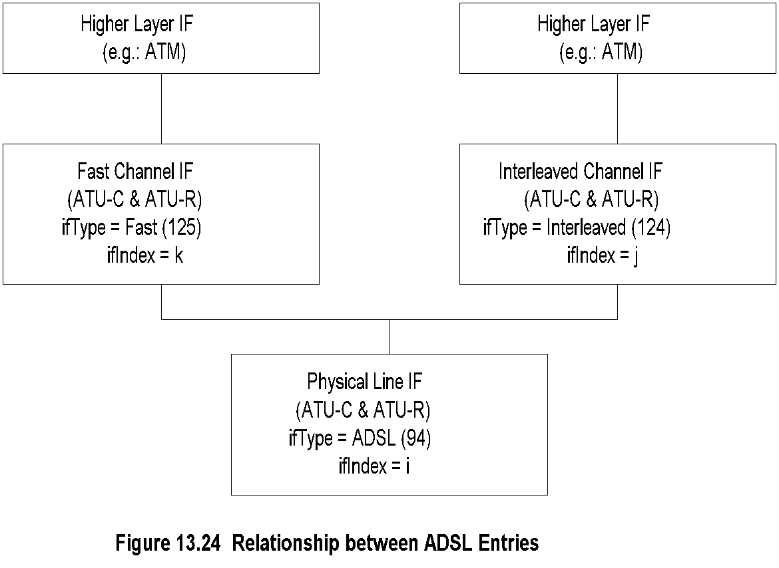
Proposed IF Types
Chapter 13 Broadband Network Management: Wired and Optical Access Networks
ADSL Operational and Configuration Profiles
There are two MIB tables to address this issue — one for configuration profile and another for the performance profile.
One of the tables is adslLineConfProfileTable {adslMibObjects 14}, which contains information on the ADSL line configuration shown in Table 13.10. One or more ADSL lines may be configured to share common profile information.
The three entries for the physical layer, the interleaved channel, and the fast channel for each ADSL line are represented by "i," "j," and "k" as discussed in Section 13.8.6. Only the ADSL line entry contains the pointer to the configuration profile table.
The ifStackTable is used to link channel entries and the corresponding physical layer to acquire the channel configuration parameters.
Notes
Sublayers handled by ifMIB ifStackTable {ifMib.ifMIBObjects 2} (RFC 1573)
Propose ifTypes adslPhysIf ::= {transmission 94} adslInterIf ::= {transmission 124} adslFastIf ::= {transmission 125}

Slide 58
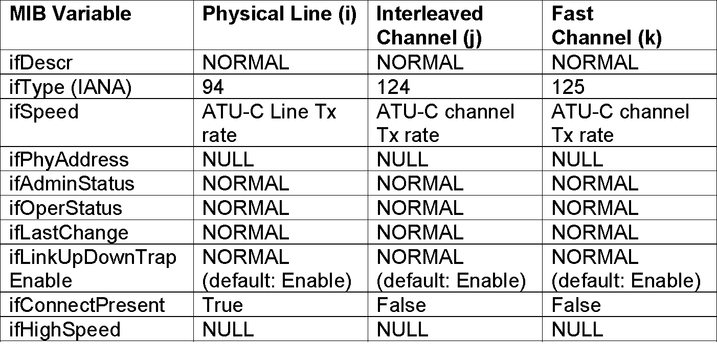
ADSL Interfaces Table
Chapter 13 Broadband Network Management: Wired and Optical Access Networks
Table 13.13 Use of Interfaces Table for ADSL
Table 13.14 shows the configuration of the operational file for ifType for each modem in setting up the fast and interleaved channels.
An iflndex is associated with each channel.
In a typical configuration of an ADSL system, the access node shown in Figure 13.19 has hundreds of ATU-Cs. It would be impractical to provision all the parameters for each ATU-C individually.
Table 13.14 ADSL Operational Profile for ifType File
ADSL Operational Configuration
Line type | Physical | Fast Channel | Interleaved Channel
Number of Channels (1) | Yes |  | Yes
Fast only (2) | Yes | Yes
Interleave only (3) | Yes |  | Yes
Fast or Interleaved (4) | Yes | Yes | Yes
Fast and Interleaved (5) | Yes | Yes | Yes

Slide 59
ADSL Profiles Management
Chapter 13 Broadband Network Management: Wired and Optical Access Networks
Figure 13.23 shows three nodes under adslLineMib.
The first is the ADSL MIB objects that we have discussed.
The other two are traps and conformance groups.
Besides the generic traps, alarms are generated by the ATU-C and ATU-R for loss of frame, loss of signal, loss of power, errored seconds threshold, data rate change, loss of link duration threshold, and ATU-C initialization failure. These are specified in adslTraps MIB.
Configuration profile
Performance profile
Alarm profile
Traps
Generic
Loss of frame
Loss of signal
Loss of power
Error-second threshold
Data rate change
Loss of link
ATU-C initialization failure
Notes

Slide 60
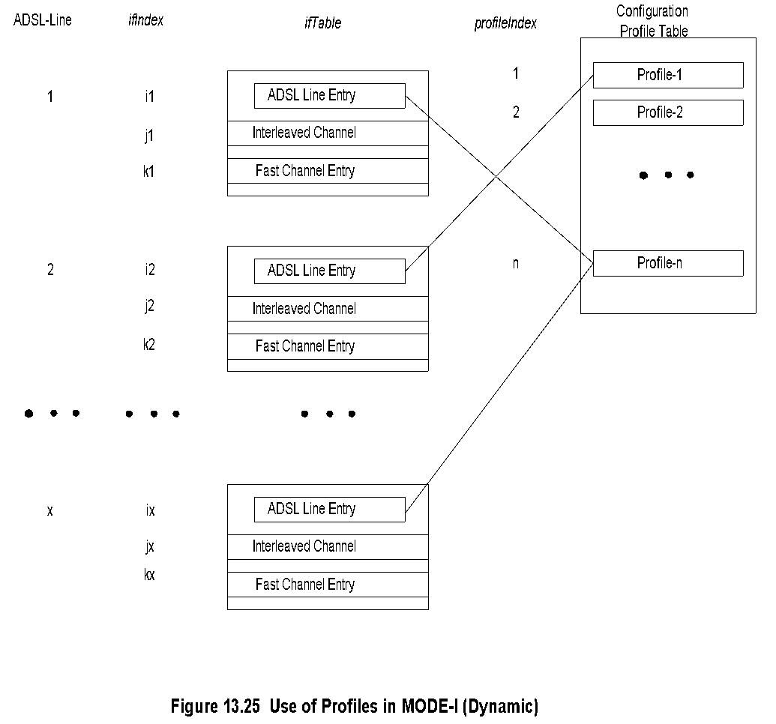
Configuration Profile: Mode I - Dynamic
Chapter 13 Broadband Network Management: Wired and Optical Access Networks
Figure 13.25 shows the dynamic mode, MODE-I, configuration profile scheme. Profile tables are created and indexed 1 to n. Each ADSL line interface, with the given value of iflndex, shown ranging from l to x shares the configuration profiles from 1 to n.

Slide 61
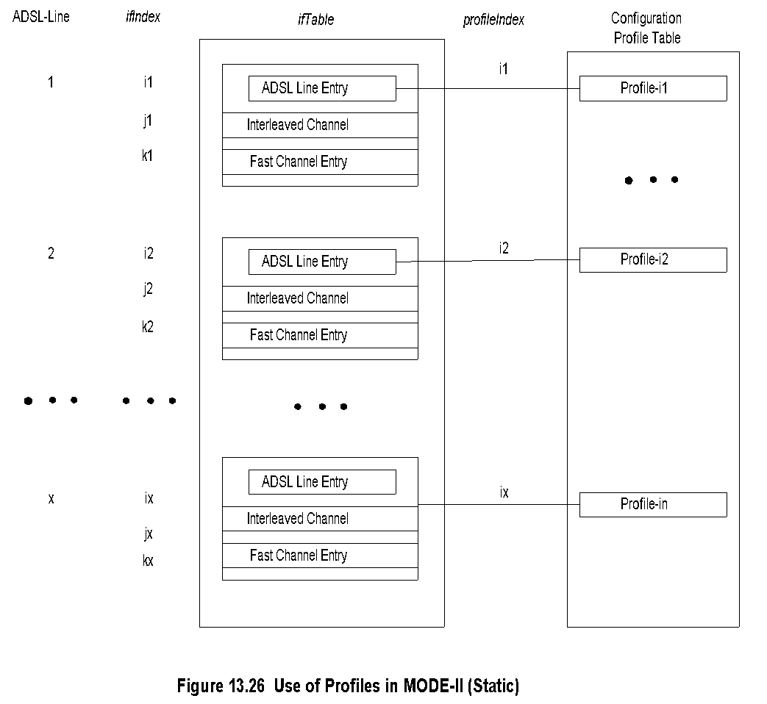
Configuration Profile: Mode II - Static
Chapter 13 Broadband Network Management: Wired and Optical Access Networks
The second mode, denoted by MODE-II, specifies the static mode of setting up ADSL configuration profile. Each ADSL line interface has a static profile, as shown in Figure 13.26.

Slide 62
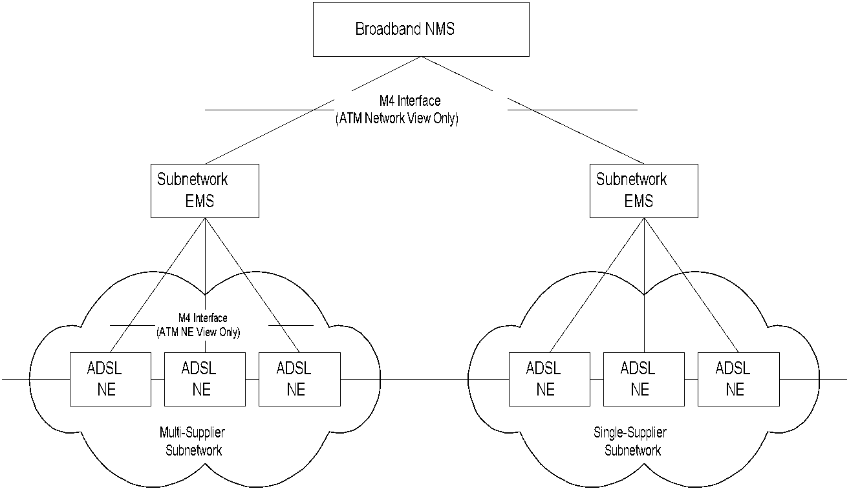
ADSL EMS-NMS Management
Chapter 13 Broadband Network Management: Wired and Optical Access Networks
The alarm profile could also be structured in a manner similar to the configuration profile.
LCS MlBs for the DMT and CAP ADSL lines are described in TR-024 and TR-015.
The tables and other information follow a similar structure and organization similar to that of the ADSL line MTB shown in Figure 13.23 ADSL SNMP MIB as {adslMib Objects 1-15}.
Notes
TMN- and ATM-based model
M4 is ATM Forum defined interface between public NMS and public network

Slide 63
ADSL2 and ADSL2+
Chapter 13 Broadband Network Management: Wired and Optical Access Networks
ADSL2 adds new features and functionality to improve performance and interoperability. Specifically, improvements include higher data rate, longer reach, rate adaptation, diagnostics, and power-saving stand-by mode.
The data rate increase is achieved by improving modulation and coding efficiencies
A downstream data rate of 12 Mbps and an upstream data rate of 1 Mbps can be achieved.
A longer reach is accomplished at the expense of lower data rate.
Rate and reach Improvements
ADSL Speed Downstream/Upstream 1/.256 Mbps
ADSL2 Standard G.992.3 July 2002
ADSL2 Lite Standard G.992.4 July 2002
Speed Downstream/Upstream 12/1 Mbps
ADSL2+ Standard G.992.5 January 2003
Speed Downstream/Upstream 24/2 Mbps
Other Major Enhancements
Diagnostics
Power enhancements
Rate adaptation
Bonding for higher data rates
Channelization and Channelized Voice-over DSL (CVoDSL)
Additional Benefits
Improved interoperability
Fast startup
All-Digital Mode
Support of packet-based services

Slide 64
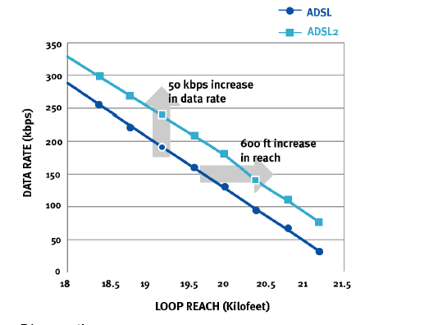
ADSL2 Rate and Reach
Chapter 13 Broadband Network Management: Wired and Optical Access Networks
In ADSL2, modulation and framing layers are decoupled, which enables the transmission data rate to be changed without affecting the framing layer. Thus, data rate is changed dynamically based on the extent of external disturbing effects of crosstalk and other parameters such as radio, temperature, and water in the binder.
Notes
Data rate increase of 50 kbps or increase of 600 feet reach achieved
Programmable overhead
ADSL 32 kbps
ADSL2 4-32 kbps
Higher coding gain from Reed-Solomon (RS) code

Slide 65
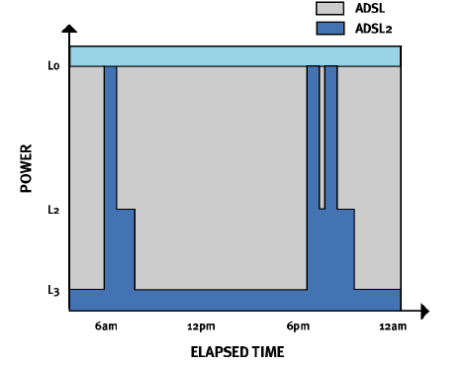
ADSL2 Power Enhancement
Chapter 13 Broadband Network Management: Wired and Optical Access Networks
Power saving is accomplished by the ADSL modems operating at three levels — very low-power sleep mode when there is no data transmission, medium-power mode when Internet traffic in the access network is normal; and high-power mode when traffic is heavy such as large file transfer.
Notes
Savings in ATU-C and ATU-R
L0 Full power
L2 Normal power
L3 Sleep mode (user not on line)

Slide 66

Seamless Rate Adaptation
Chapter 13 Broadband Network Management: Wired and Optical Access Networks
ADSL2 provides the ability to split the bandwidth into different channels with different link characteristics for different applications.
ADSL2+ specifications double the downstream data rate to 2.2 Mbps by limiting the reach to under 5,000 meters.
As VDSL does not completely satisfy the needs of triple play service, the Broadband Forum has created VDSL2+, which is a complex protocol and incorporates features and characteristics of ADSL, ADSL2+, and VDSL protocols.
Notes
Telephone cable in bundle of 25 or more
Next and Fext can cause connection drop
SRA (Seamless Rate Adaptation) decouples modulation and framing layers

Slide 67
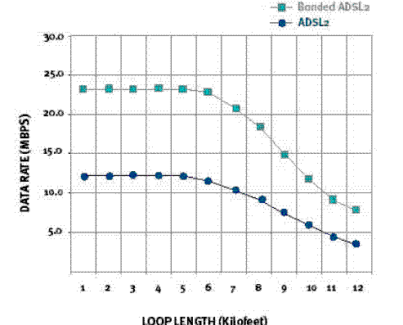
Bonding for Higher Data Rates
Chapter 13 Broadband Network Management: Wired and Optical Access Networks
Notes
Bonds two or more UTP using ATM IMA (Inverse Multiplexing for ATM)
New sublayer between PHY and ATM

Slide 68
Other ADSL2 Enhancements
Chapter 13 Broadband Network Management: Wired and Optical Access Networks
Diagnostics by use of enhanced transreceivers
Line noise
Loop attenuation
SNR (Signal-to-Noise ratio)
Improved interoperability due to initialization of state machine
Fast startup
Transmission of ADSL data in the voice bandwidth
Ethernet over ADSL2
Notes

Slide 69
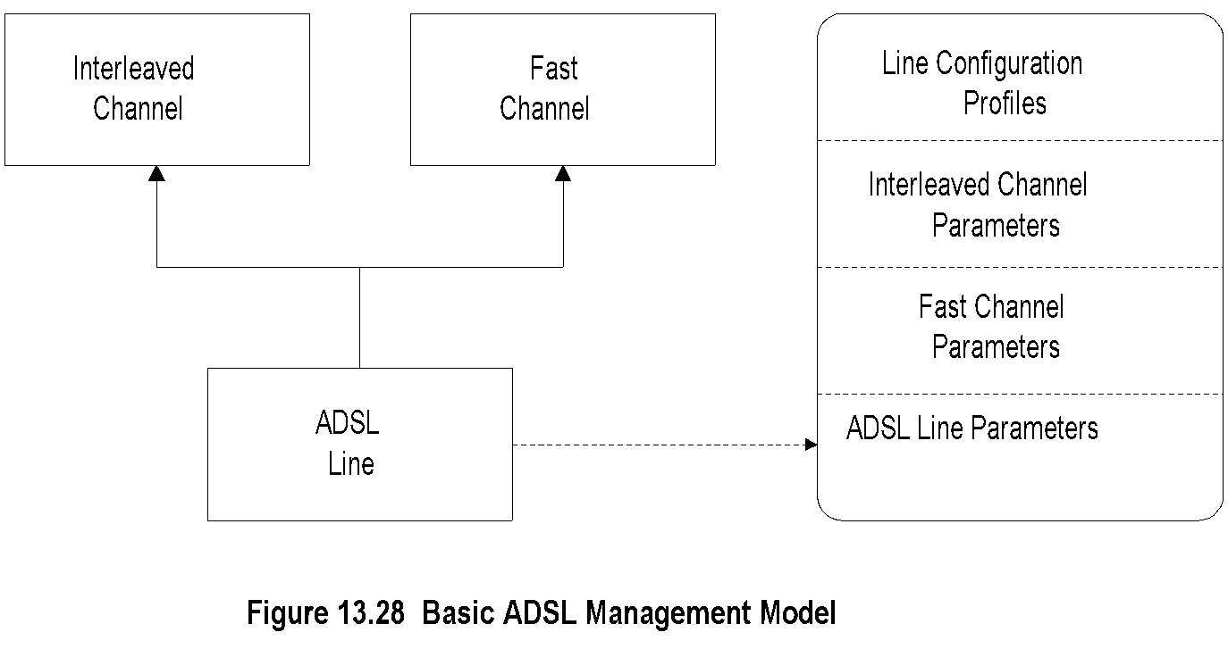
Basic ADSL Management Model
Chapter 13 Broadband Network Management: Wired and Optical Access Networks
Notes
Supports a simple and fixed channel
Fast channel
Interleaved channel or
Both

Slide 70
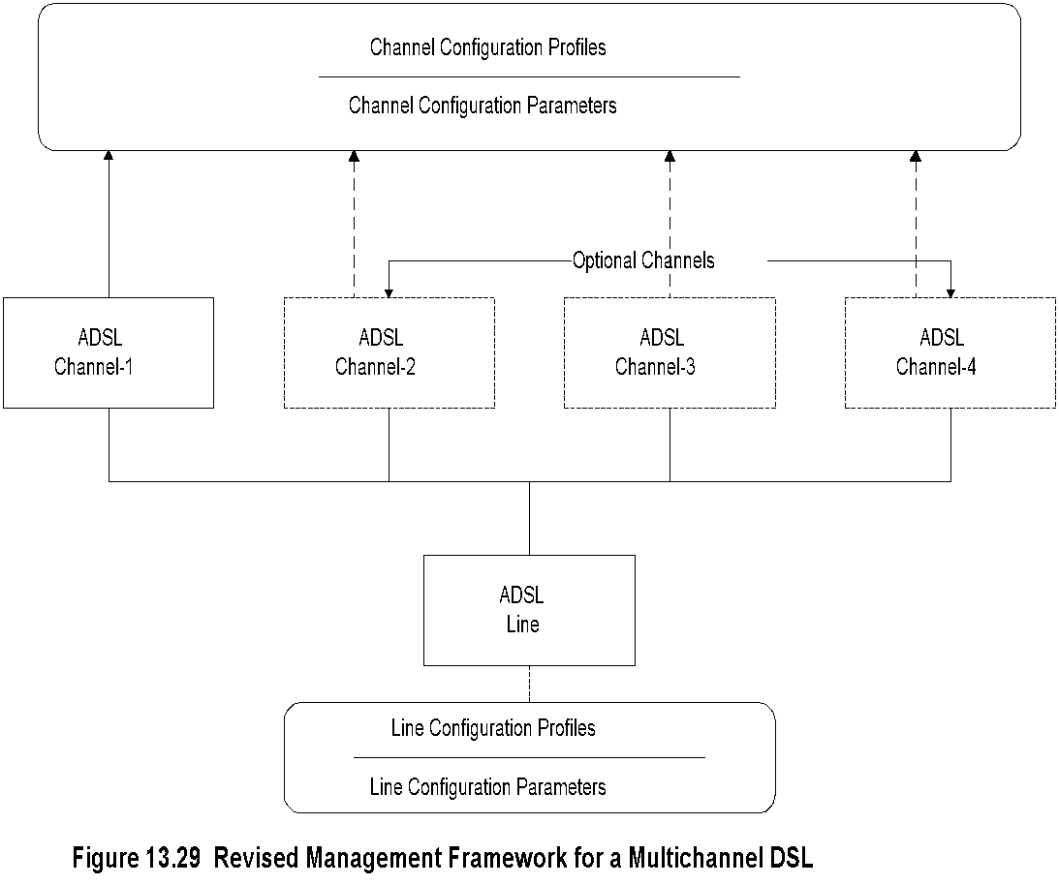
Multichannel DSL Management
Chapter 13 Broadband Network Management: Wired and Optical Access Networks
Figure 13.29 shows the revised management model for the next generation technologies. Bearer channel parameters are decoupled from ADSL line parameters into independent profiles.
Notes
Decouple channel parameters from line parameters
Up to four generic channels
Flexible configuration
Many combinations of parameters to manage

Slide 71
Passive Optical Network
Chapter 13 Broadband Network Management: Wired and Optical Access Networks

Slide 72
Passive Optical Network
Chapter 13 Broadband Network Management: Wired and Optical Access Networks
Fiber Medium
No active elements in the transmission medium
Passive elements in the fiber medium
Beam splitter – Lossy
Wavelength Division Multiplexer (WDM)
Notes
The third "wired" broadband access network that we consider is the passive optical network (PON).
It is not really wired but the copper is replaced with fiber, although PON can also be implemented on copper.
Optical access networks use optical fiber transmission from the central office to the customer premises.
The transmission path could have active elements such as regenerative repeaters or amplifiers.
Passive elements such as a beam splitter or a wavelength division multiplexer (WDM).

Slide 73
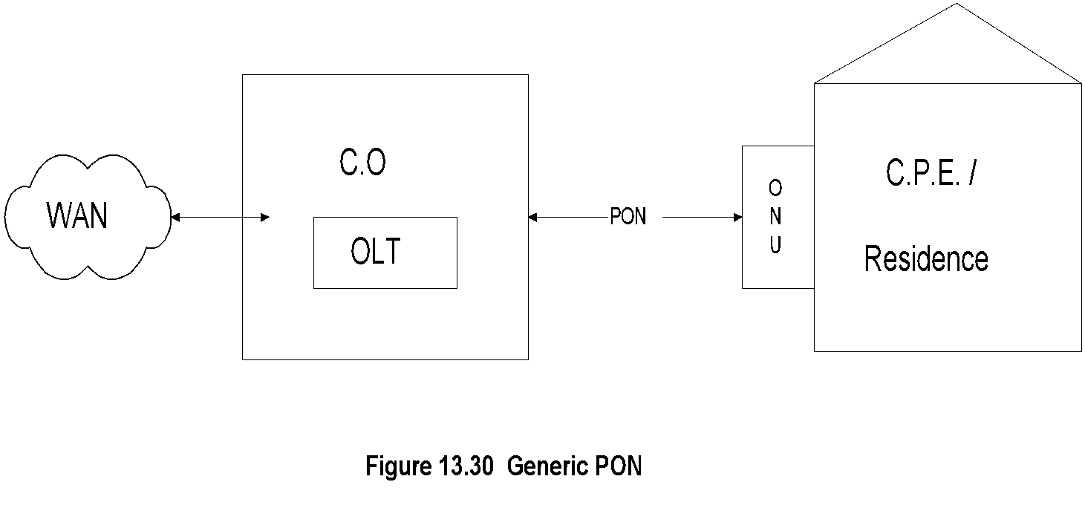
Generic PON Architecture
Chapter 13 Broadband Network Management: Wired and Optical Access Networks
A generic representation of PON is shown in Figure 13.30.
It is the segment between the optical line termination (OLT) that is located in the central office (CO) and the ONU equipment that is located in the customer premises (CPE) or home.
Notes
Optical Line Termination (OLT) in central office
Optical Network Unit (ONU) in customer residence
Shared or dedicated optical path
1-way and 2-way transmission using separate physical or optical wavelength (λ) path
Dedicated fiber (λ) vs. shared medium multiple (λ)
3 deployment configurations
Dedicated fiber
EPON
WDM

Slide 74
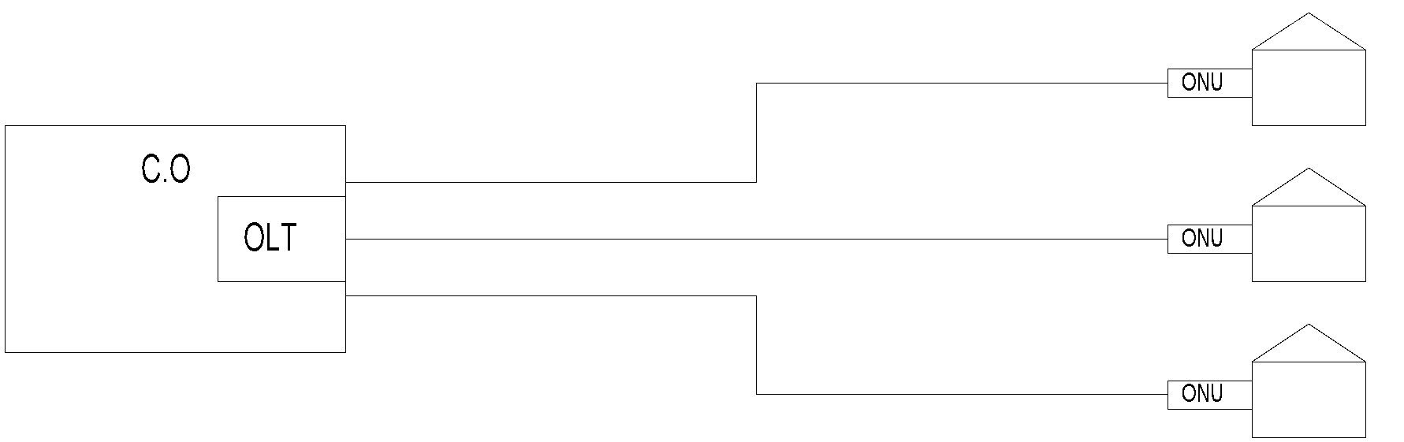
PON Configurations: Dedicated Fiber
Chapter 13 Broadband Network Management: Wired and Optical Access Networks
Figure 13.31 shows three different schemes of PON.
Figure 13.3 1(a) shows the configuration where fiber is run from an OLT to each ONU.
In this case, ONU performs a similar function to the NIU as in the cable access network.
Figure 13.31(a) PON Configuration (Point-to Point PON)
Notes
Dedicated fiber from OLT to each ONU
ONU function similar to ONU in cable access network
One-way in each fiber / Dual wavelength fiber for 2-way
Expensive configuration

Slide 75
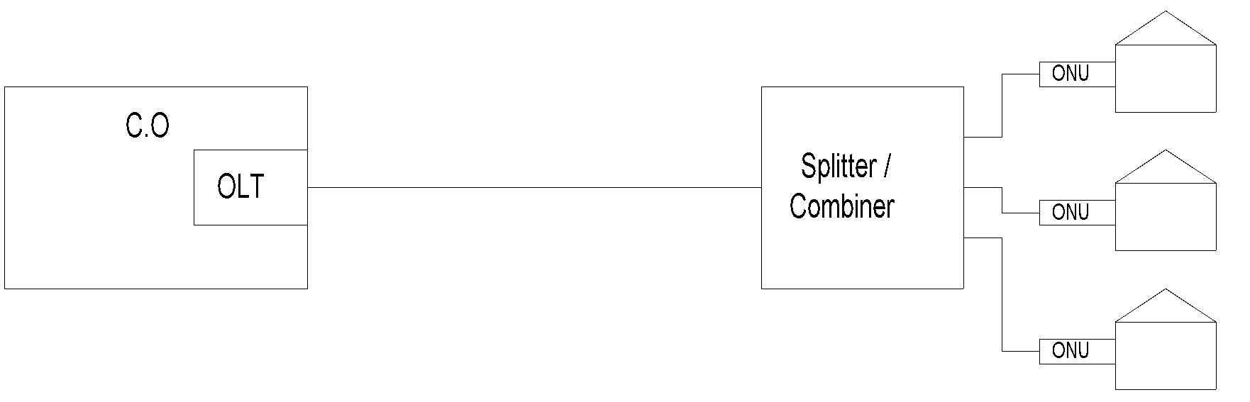
PON Configuration: EPON
Chapter 13 Broadband Network Management: Wired and Optical Access Networks
In Figure 13.31(b), the ONU is a passive optical power splitter-combiner, which distributes the signal to multiple homes.
The link between OLT and the passive optical splitter-combiner in this case uses Ethernet or ATM protocol.
The Ethernet PON is called EPON.
The optical signal between ONU and OLT in Figure 13.31(a) and (b) in two directions could be carried on two different wavelengths or on a pair of fibers.
Figure 13.31(b) PON Configuration (EPON)
Notes
Shared optical fiber from OLT to power splitter / combiner
Twisted pair or Cat-x cable from splitter / combiner to ONU
Modified Ethernet MAC protocol for EFM (Ethernet First Mile)
Downstream TDM and upstream TDMA
MIB specified only for EPON

Slide 76
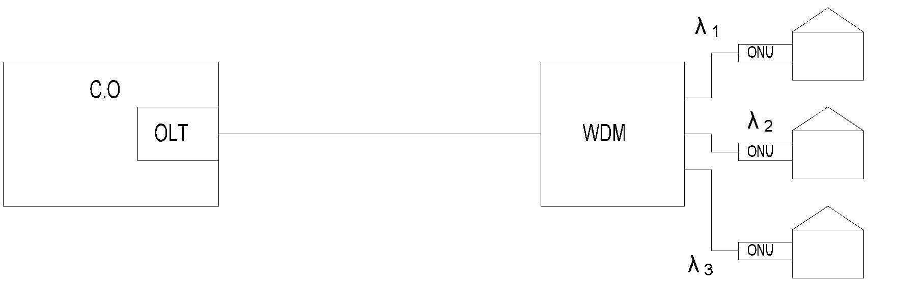
PON Configuration: WPON
Chapter 13 Broadband Network Management: Wired and Optical Access Networks
Figure 13.31(c) shows the configuration where individual homes are served over different wavelengths. The WDM is the ONU that multiplexes and demultiplexes signals from and to homes.
As we noted, different modes of transmission distribution are used in PON.
APON is ATM-based, EPON is Ethernet-based, and PON-GPON is a hybrid that uses EPON and APON systems.
The EPON network is also known as EFM (Ethernet in the First Mile).
WDM PON is also termed as WPON.
EPON transmission is done using Ethernet packets. Downstream is TDM broadcast mode and upstream is TDMA.
EPON uses packets of variable size.
TDM and TDMA use a fixed-window size and hence are not suitable.
Figure 13.31(c) PON Configuration (WPON)
APON is ATM-based, EPON is Ethernet-based
Notes
Shared single fiber from OLT to WDM
Multiple (λ), one to each ONU
DWDM (Dense WDM) special case of WDM

Slide 77
EPON MAC Protocol
Chapter 13 Broadband Network Management: Wired and Optical Access Networks
Point-to-Multipoint architecture
OLT with n virtual ports communicates with n ONUs
Communication established through virtual tunneling
Different from IP/SNMP used for traditional 802.3 -> 802.3ah
Some management capabilities are embedded in Ethernet layer
802.3ah defines both physical and MAC layer
Modified gigabit Ethernet protocol
PON link based on shared optical fiber with optical splitter dividing the subscribers
Multipoint control protocol embedded in MAC layer to control EPON subscribers
Emulation layer creates virtual private path to each ONU
FEC error correction
802.1d – modified bridge – in the MAC layer sets up peer-to-peer communication between OLT and ONU
Management layer embedded in MAC layer for OAM
Notes
Network Management: Principles and Practice
© Mani Subramanian 2010
*

Slide 78
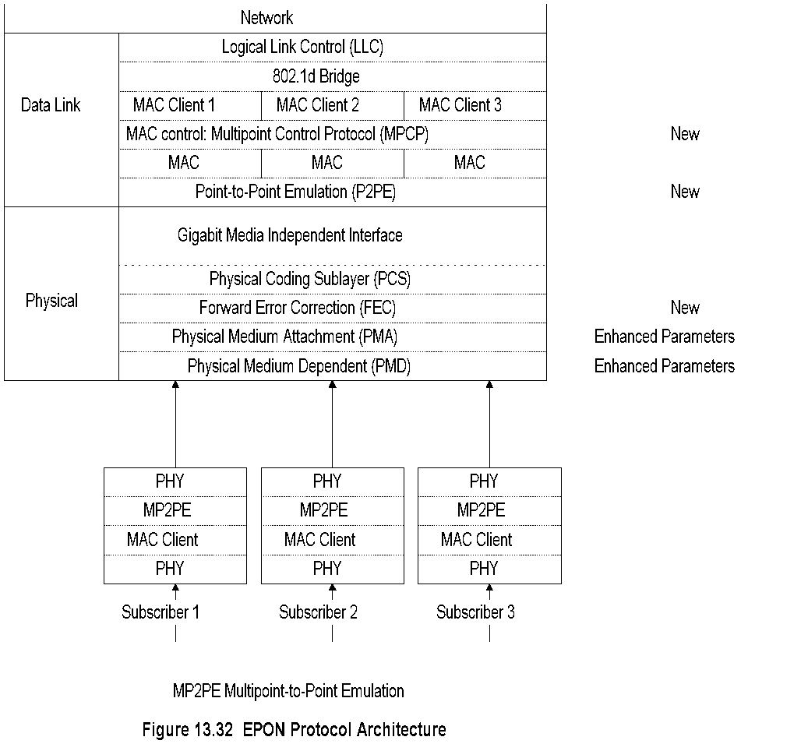
EPON Protocol Architecture
Chapter 13 Broadband Network Management: Wired and Optical Access Networks
Notes
Network Management: Principles and Practice
© Mani Subramanian 2010
*

Slide 79
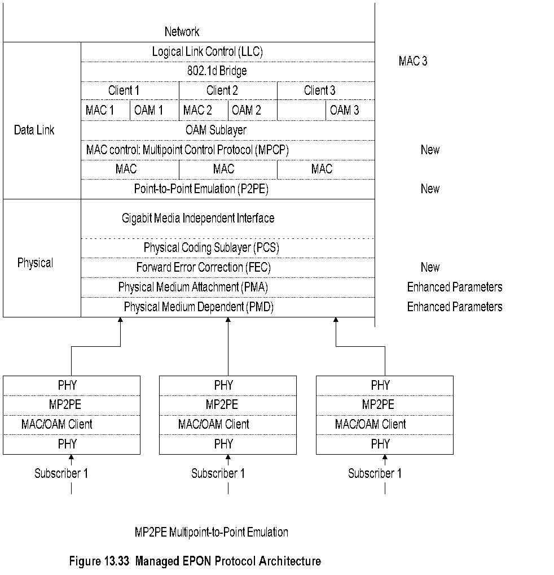
Managed EPON Protocol Architecture
Chapter 13 Broadband Network Management: Wired and Optical Access Networks
Network Management: Principles and Practice
© Mani Subramanian 2010
*

Slide 80
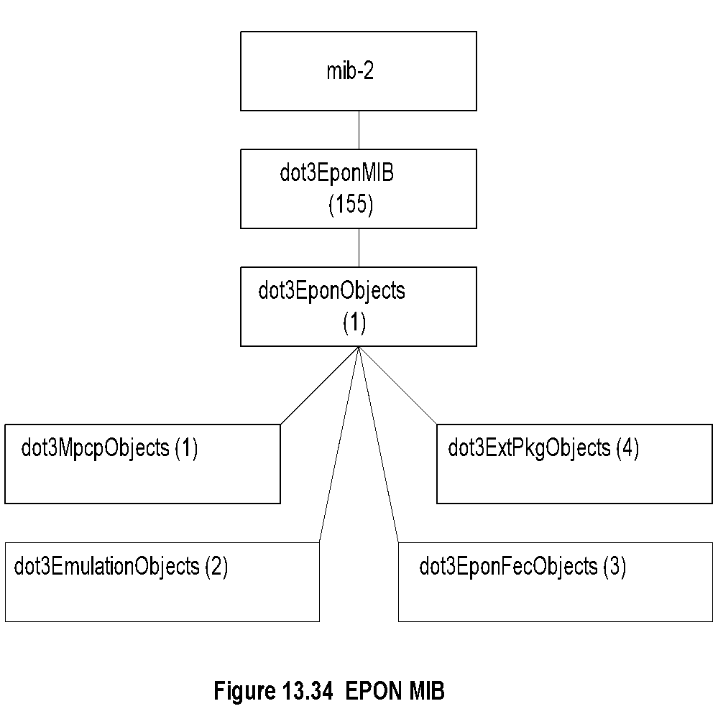
EPON MIB
Chapter 13 Broadband Network Management: Wired and Optical Access Networks
Notes
Network Management: Principles and Practice
© Mani Subramanian 2010
*

Slide 81
EPON Group
Chapter 13 Broadband Network Management: Wired and Optical Access Networks
Table 13.16 EPON Group
Entity | OID | Description (brief)
dot3EponMIB | Mib-2 155 | EPON MAC
dot3EponObjects | dot3EponMIB 1 | EPON MIB objects
dot3MpcpObjects | dot3EponMIB 1 | 802.3ah MPCP attributes
dot3EmulationObjects | dot3EponMIB 2 | Point-to-point OMP emulation attributes
dot3EponFecObjects | dot3EponMIB 3 | EPON FEC attributes
dot3ExtPkgObjects | dot3EponMIB 4 | Configuration and status attributes of Extended EPON
Notes
Network Management: Principles and Practice
© Mani Subramanian 2010
*

Slide 82
ONU Interface MIB Example
Chapter 13 Broadband Network Management: Wired and Optical Access Networks
Table 13.17 ONU Interface MIB Example
Interface MIB Object | Optical Interface Value | ONU Interface Value
ifIndex | 1 | 100
ifDescr | “Interface Description” | “Interface Description”
ifType | ethernetCsmacd (6) 1000base-Px | ethernetCsmacd (6) 1000base-Px
ifMtu | MTU size (1522) | MTU size (1522)
ifSpeed | 1000000000 | 1000000000
ifPhysAddress | ONU_MAC_Address | ONU_MAC_Address
Notes
Network Management: Principles and Practice
© Mani Subramanian 2010
*

Slide 83
OLT Interface MIB Example
Chapter 13 Broadband Network Management: Wired and Optical Access Networks
Table 13.18 ONU Interface MIB Example
Interface MIB Object | Optical Interface Value | ONU Interface Value | ONU Interface Value | ONU Broadcast Interface Value
ifIndex | 2 | 200001 | 200002 | 265535
ifDescr | “Interface Description” | “Interface Description” | “Interface Description” | “Interface Description”
ifType | ethernetCsmacd (6) 1000base-Px | ethernetCsmacd (6) 1000base-Px | ethernetCsmacd (6) 1000base-Px | ethernetCsmacd (6) 1000base-Px
ifMtu | MTU size (1522) | MTU size (1522) | MTU size (1522) | MTU size (1522)
ifSpeed | 1000000000 | 1000000000 | 1000000000 | 1000000000
ifPhysAddress | OLT_MAC_Address | OLT_MAC_Address | OLT_MAC_Address | OLT_MAC_Address
Notes
Network Management: Principles and Practice
© Mani Subramanian 2010
*

